Slide 1
Things to
be Thankful
for Today

Slide 2
C
Cultivating
Compassion
Why we need compassion:
We are shaped by experience
Chapter 2
Notes:
CMW Ch. 2 plus additional content

Slide 3
Today’s Agenda
Things to be Thankful for Today
Shaped by environment
How might you be different?
Socialization of females/males
Neuroplasticity
Breath awareness practice

Slide 4
Our Environments Shape Our…
Environment
Experiences
Development
Behavior
Emotions
Cognitions
Gene expression
Brain development

Slide 5
How might you be different?
Imagine you were raised in a very different environment.
What would it have been like?
How might you be different?

Slide 6
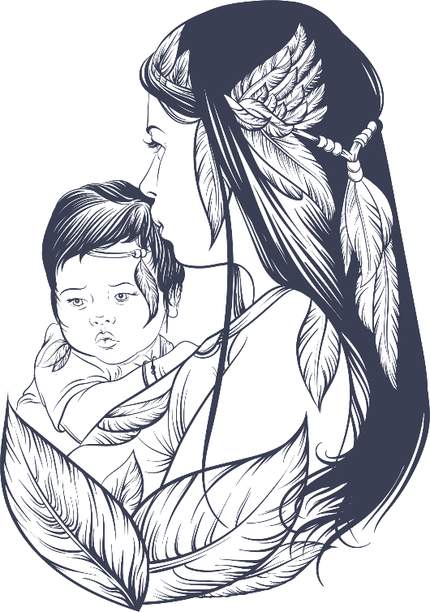
Socialization of Females & Males
Can result in different experiences
Some variation by gender in how compassion is expressed
Nurturer
Protector
Not always recognized as compassion
Notes:
Instructor Notes:
Revisiting the idea that different demographic characteristics, such as sex or gender, can affect the way people treat us, which is part of our environments.
Different socialization practices that are commonly gender-typed can result in different experiences and differentially impacts people’s perceptions of how compassion is expressed (not just in the behaviors that develop and are expressed but also in the ‘interpretation’ of those expressions)
No data to support that women are more compassionate than men
Evidence of ‘compassionate instinct’ among humans and animals with no gender differences (promoting thriving and reproduction more broadly)
However, some evidence of different patterns in brain activation while experiencing compassion
Different regions of brain were more/less activated, suggesting genders may differ in how compassion is experienced and expressed
Socialization and neuroplasticity; experience communicating emotions
Information from -
https://www.psychologytoday.com/us/blog/feeling-it/201306/are-women-really-more-compassionate
http://www.pewsocialtrends.org/interactives/strong-men-caring-women/?utm_source=Pew+Research+Center&utm_campaign=c71b80b2ef-EMAIL_CAMPAIGN_2018_07_27_04_23&utm_medium=email&utm_term=0_3e953b9b70-c71b80b2ef-399785101

Slide 7
What is Brain Plasticity?
Neuro = neurons (nerve cells) in the brain that generate electrical activity
Plasticity = changeable, adaptable, modifiable
Notes:
Instructor Notes:
Brain plasticity is also referred to as neuroplasticity, and what this means is that the human brain has the amazing ability to reorganize itself by forming new connections between brain cells (neurons), and the ability create new connections with activity and different experiences.
Synaptic plasticity, or neuroplasticity, is a highly dynamic process in which connections between neurons fade away or strengthen depending on how frequently they’re used.

Slide 8
Neuroplasticity
Occurs throughout life!
Notes:
Instructor Notes:
So, neuroplasticity is the ability of the brain to modify its connections or re-wire itself. We’re constantly going through neuroplasticity throughout our life. Without this ability, any brain (not just the human brain) would be unable to develop from infancy through adulthood or recover from brain injury.
What’s interesting is that for a long time, it was believed that this process ended in early childhood – it was thought that as we aged, the connections in the brain became fixed and then simply faded. However, research has shown that, in fact, neuroplasticity occurs in the brain throughout life! It is most “sensitive” or abundant early in our lifespan when the brain is organizing itself, but many aspects of the brain can be altered (or are ‘plastic’) – so, this process continues – throughout adulthood.
It also occurs in instances of brain injury, as a way to compensate for functions that may have been lost or maximize remaining functions.

Slide 9
“Your brain – every brain – is a work in progress. It is ‘plastic.’ From the day we’re born to the day we die, it continuously revises and remodels, improving or slowly declining, as a function of how we use it.” Michael Merzenich
Notes:
Instructor Notes:
thebestbrainpossible.com

Slide 10
Neuroplasticity
Importance of experience
Specifics of brain structure and growth depend on genes and maturation, but even more on experience.
Learning and practicing new skills!
Notes:
Instructor Notes:
Opportunities to strengthen certain neural connections depends heavily on the amount and type of stimulation we receive from our environments, starting from before we’re even born!
So, the environment in which a person lives, as well as the actions of each person, play a significant role in plasticity.
Learning new skills, such as learning a new language or how to play an instrument – even learning a new route to drive to school or brushing your teeth with your less dominant hand – can facilitate this plasticity. Learning any new skill or changing the way you do your day-to-day activities helps to modify the connections in your brain and drive this neuroplasticity. Because when we do this, we’re creating new networks and new neural pathways.
So, our brain structure and function are (literally) physically shaped by all those things we do repeatedly in our lives – behaviors, emotions, and even thoughts. Of course, this can work both for and against us, depending on what things we continue to do, or reinforce…
Neuroscience tells us that neuronal pathways that are used frequently while we’re young are more likely to be used in the future.
help this connective process along, making sure that certain behaviors (in our kids) become second nature
become their default way of being — the platform from which they approach the world

Slide 11
Experiences Build Brain Architecture
Notes:
Instructor Notes:
Video Experiences Build Brain Architecture 1:56
https://www.youtube.com/watch?v=VNNsN9IJkws&t=1s

Slide 12
Neuroplasticity
The ability of the brain to reorganize itself, both in structure and how it functions
How the brain changes
Strengthened Synapses
Weakened Synapses
Neurogenesis
New Synapses
Continuous generation of new neurons in certain brain regions
New skills and experiences create new neural connections
Repetition and practice strengthens neural connections
Connections in the brain that aren’t used become weak
Notes:
Instructor notes:
strengthens some connections, while leaving other connections undeveloped or underdeveloped
This strengthening happens by plain old deliberate practice

Slide 13
Notes:
Breath awareness meditation

