Slide 1
Things to
be Thankful
for Today

Slide 2
C
Cultivating
Compassion
Why we need compassion:
We have tricky brains
Introduction & Chapter 1

Slide 3
Today’s Agenda
Things to be Thankful for Today
Breath awareness practice
What’s in a word?
Quality of mind needed
Tricky brains (Old & New)
Brain loops

Slide 4
Notes:
Breath awareness meditation

Slide 5
Compassionate Exemplars
Famous people who have exemplified compassion
What do they have in common?

Slide 6
What’s in a word?
What words do you associate with compassion?

Slide 7
Compassion Defined
Compassion is a sensitivity to suffering in self and others, with a commitment to alleviate and prevent it.

Slide 8
Qualities of Mind Needed
Preparedness to pay attention to things that are difficult without turning away, avoiding, or switching off
Develop the courage to turn toward difficulties
Develop wisdom and skills to help

Slide 9
We have tricky brains
A cornerstone of compassion is wisdom
Need to understand our brains
Ability to think, imagine, plan, reflect
Positive and negative

Slide 10
3 main parts of your brain
Notes:
The three main parts of your brain by Dr. Russ Harris (3:07)
https://youtu.be/5CpRY9-MIHA

Slide 11
Old Brain
Basic Motives
harm-avoidance, seeking food, reproduction, competition, caring
Basic Emotions
anger, anxiety, disgust, sadness, joy
Defensive Behaviors
fight, flight, freeze, submission, clinging

Slide 12
New Brain
Imagination - ability to imagine things
Planning - consider the future
Worry
Metacognition – thinking about thinking
Self-awareness
Reflect on the past
Rumination

Slide 13
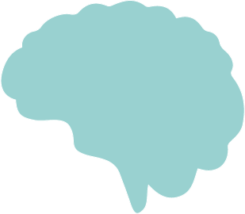
Old and New ‘Loops’
New Brain Competencies
Imagination, Planning, Worry,
Self-awareness, Rumination
Old Brain Competencies
Motives - caring, competition,
harm-avoidance
Emotions - anger, anxiety, sadness, joy
Behaviors - fight, flight, submission

Slide 14
Old and New ‘Loops’
New Brain:
I’m not a good friend –
it’s my fault
New Brain:
Why didn’t I get invited?
New Brain:
Maybe because I didn’t send her a b-day card
Old Brain:
Anxiety and
(self-directed) Anger
New Brain:
She’s so petty, she knew why I didn’t send the card
Old Brain:
Heart racing, tense muscles, anxiety
Old Brain:
Anxiety and
(self-directed) Anger
Old Brain:
(outwards-directed)
Anger

Slide 15
What ‘loops’ have you experienced?

