Slide 1
E
U N D E R S T A N D I N G
E M P A T H Y
MODULE 2.4
Empathy and Relationships

Slide 2

At the core of an empathetic relationship is that each person is interested in the other’s subjective experience without judgment or placing one’s own subjective experience onto the other.
People are valued for their unique perspectives even if they are different than one’s own.

Slide 3

Empathy is not a continuous state. It is done moment by moment and is often situational.
Empathy can be challenging as stress in our everyday lives prompt flight or fight responses. But, inter-subjectivity (a way of thinking of the other) takes practice, and we need to regularly apply energy to maintain healthy relationships.

Slide 4

Need to have balance and complementarity in long term relationships.
Long Term Relationships
Need to have balance between freedom and connection - “feel free from being controlled by the other person, yet connected enough to care about their well-being.”
Balance includes establishing healthy psychological boundaries.
Complimentary means valuing each other’s contributions to a relationship and providing gratitude for one another.
Notes:
Discussion Questions: Think about the different types of relationships, past or present, you have in your life. What is your experience with empathy in these relationships (either as a receiver or a giver of empathy)?
How have your past life experiences shaped your capacity for empathy? How are your current life situations, including any current stressors in your life, affecting your capacity for empathy?

Slide 5

Various Kinds of Relationships

Slide 6

Empathy toward others may be easier or more difficult to accomplish depending on the type of relationship.
The degree of closeness, or how much a person’s life influences the other, can affect capacity for empathy, and how the relationship either triggers positive or negative emotions.

Slide 7

LOW-INFLUCENCE RELATIONSHIPS
Often provide opportunities for empathetic behavior.
Include interactions we have with acquaintances, or low stakes encounters with grocery store clerks, baristas, others in line, etc.
We are capable of creating opportunities to be empathetic and connect with others in these types of relationships.

Slide 8
High-Influence Relationships

Slide 9

High-influence relationships often have an ongoing impact on our well-being.
These include our relationships with immediate family, spouses, romantic partners, close colleagues, and good friends.
These relationships may also include people in authority where the relationship may not be ongoing but still influential.

Slide 10
CHILDHOOD TRAUMA OR ABUSE AND SKEWED RELATIONSHIP MODELS CAN TRIGGER PSYCHOLOGICAL RESPONSES THAT INTERFERE WITH EMPATHY.
INSECURE ATTACHMENTS IN THE PAST CAN NEGATIVLY IMPACT EMPATHY AND OTHER POSITIVE BEHAVIORS IN FUTURE, ROMANTIC RELATIONSHIPS.

Slide 11

Empathy for our Enemies and for People who have hurt us deeply

Slide 12

Certain negative situations can make it difficult for us to engage in empathetic behaviors.
It is often difficult for us to forgive a close friend, colleague, partner who has betrayed our trust, for example.
In high-influence relationships, we allow others into our lives which may include opening up to certain vulnerabilities. We expect those close to us not to take advantage of our vulnerability.

Slide 13

Overall, an empathetic understanding of those who hurt us deeply may be helpful in motivating us to change the social conditions that create them.
Insights about those who have hurt us may help us recognize how good others are.
Even thinking of others in a different capacity can help alleviate the fight or flight response so that we do not immediately retaliate.
We should not let some negative experiences with others shade our perceptions of the human race.
Notes:
Activity: Empathy for your Adversary

Slide 14
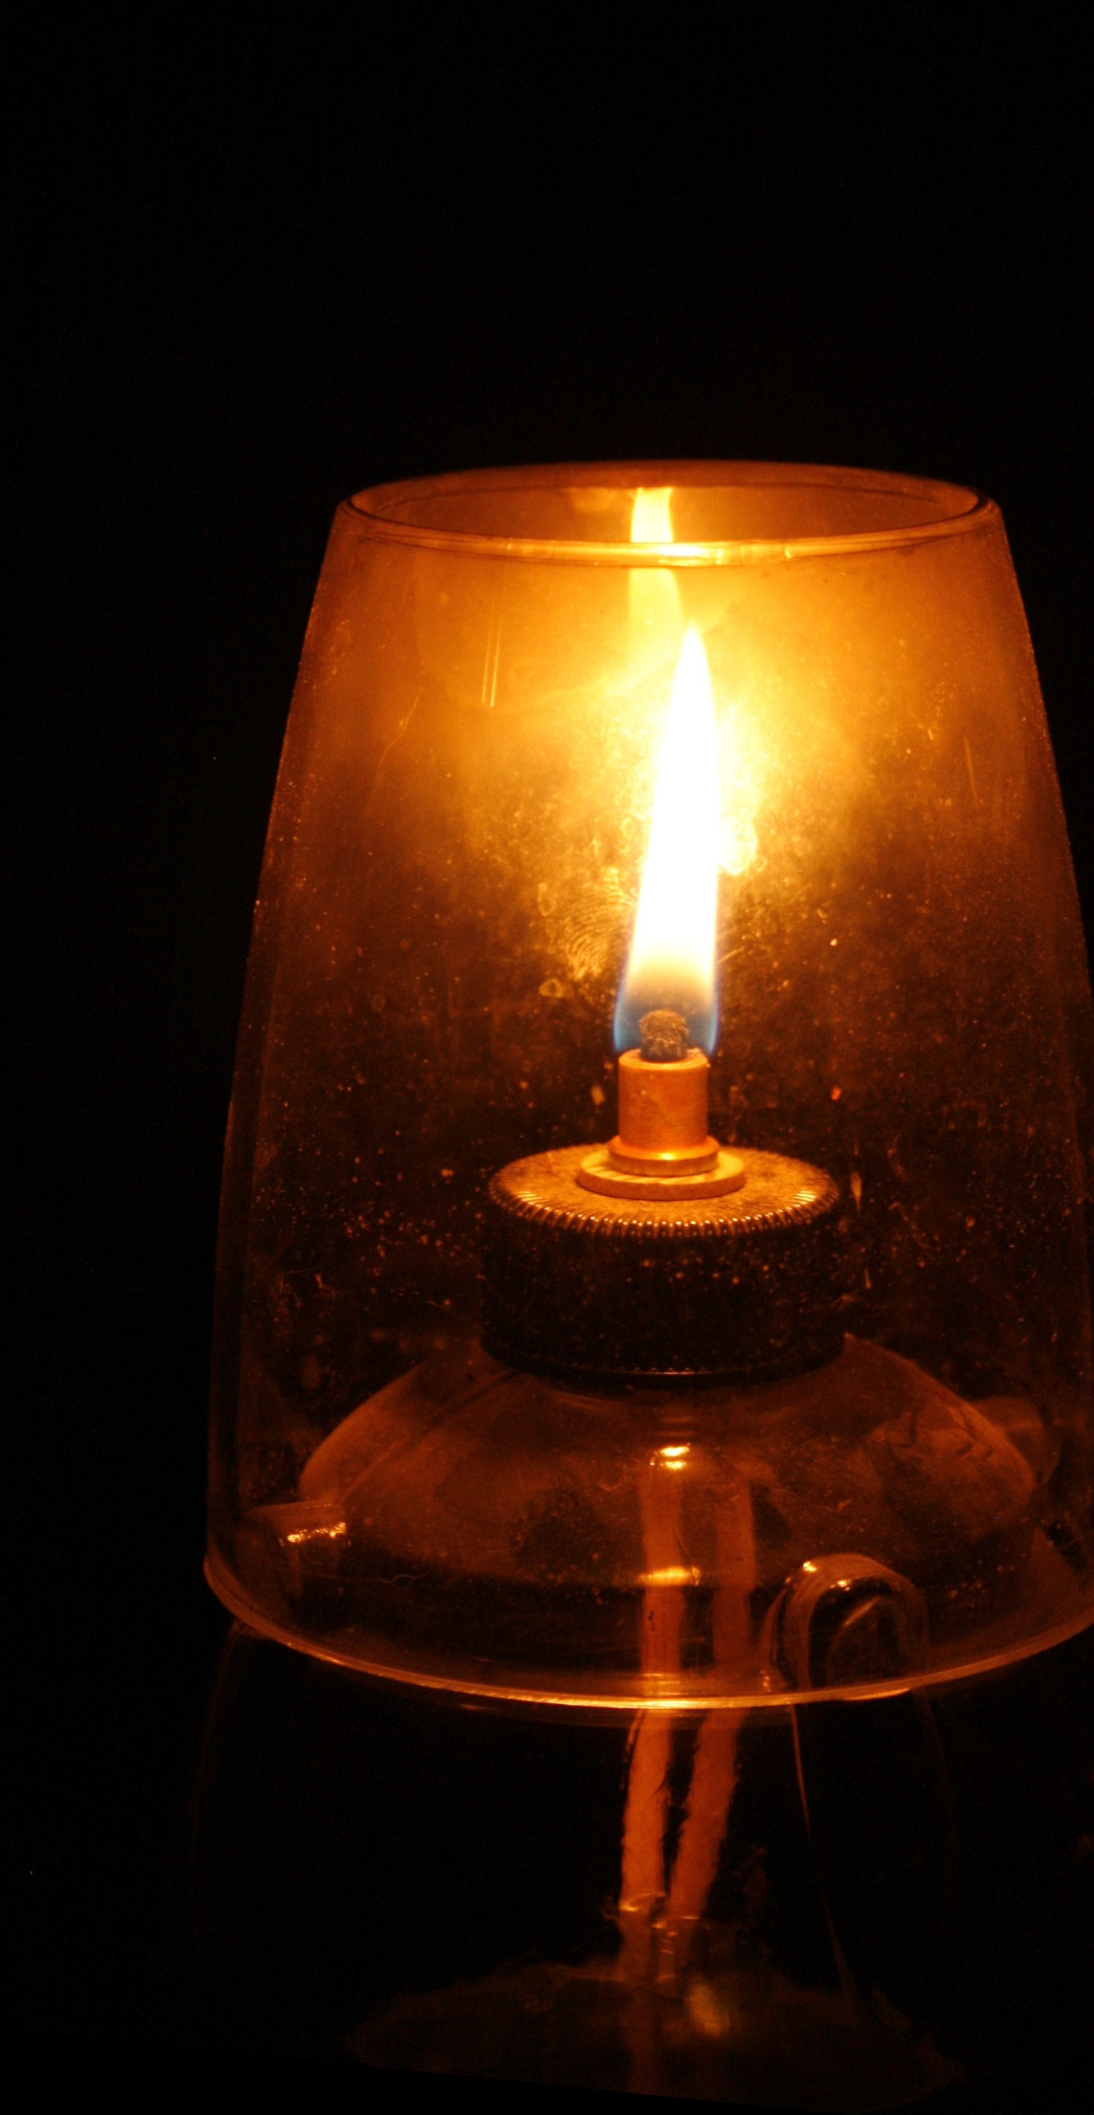
Lastly, we all have the capacity to be hurtful. Allowing us to think about others who have hurt us can illuminate behaviors we need to curtail in ourselves.

Slide 15

ACTIVITY
LOVING KINDNESS MEDITATION
This meditation goes through a list of just thinking about people in our lives and offering them to be happy, healthy, peaceful and safe. This meditation provides practice of paying attention to ourselves and others with interest and care. It can help us feel less negative about ourselves and others, especially with those we find frustrating or difficult.

