Slide 1
E
U N D E R S T A N D I N G
E M P A T H Y
MODULE 2.2
Empathy and Physiology

Slide 2
Mirror Neurons
Mirror neurons: brain cells that promote mimicry of others.
Through mirror neurons, an individual observes another individual, and that information is processed within the rest of the brain which results in actions, thoughts, and emotions that are all based on the original information from the observation.
We use mirror neurons to imagine how others may be feeling and how we should/could respond in an appropriate way that is related the other’s feelings.
Our response can include our facial expressions, posture, and speech patterns, which begin to mimic those of the other person.

Slide 3
Oxytocin and Empathy

Slide 4
Oxytocin is a hormone that plays a critical role in the coordination of social bonds and emotions and the reduction of behavioral reactivity in response to stress.
Oxytocin is related to trust, emotion regulation, and emotion sharing provides a basis for identifying how oxytocin and empathy are related; all of the aforementioned behaviors are important precursors of and foundation for empathic responding.

Slide 5
Our body's response to perceived threat
When faced with a perceived threat, we will either:
FIGHT
or
FLIGHT
confront the
situation
avoid/flee the
situation
Notes:
Activity: Exploring the fight or flight responses

Slide 6
When we enter this fight/flight response, our body releases adrenaline to prepare for our response which changes our physiological functioning.
It also results in more mental alertness and our cognitions become more goal-oriented and focused, which results in reduced perspective taking, therefore compromising our ability to be empathetic.
Notes:
Discussion Question: Share a situation that activated your fight/flight response. Thinking back, how might this have interfered with your ability to behave empathetically? Knowing what you know now about physiological and empathy, how might you overcome or address that interference?

Slide 7
Psychological Functioning and Physiological Arousal

Slide 8
Typical response
When faced with an acute stressor people sometimes show increased trust/trustworthiness and sharing, immediately following the stressful situation.
Physiological Arousal triggered by anger/fear
Anger elicited the arousal, an individual may be more likely to speak or act in ways that are for the greater good.
If faced with both anger and fear, one may feel extreme panic or rage; ultimately, this individual will be less likely to think clearly in the situation.
Notes:
Discussion question: How might overt anger vs. more passive anger influence how empathetic you view someone?

Slide 9
Physiological Arousal and Being Empathic

Slide 10
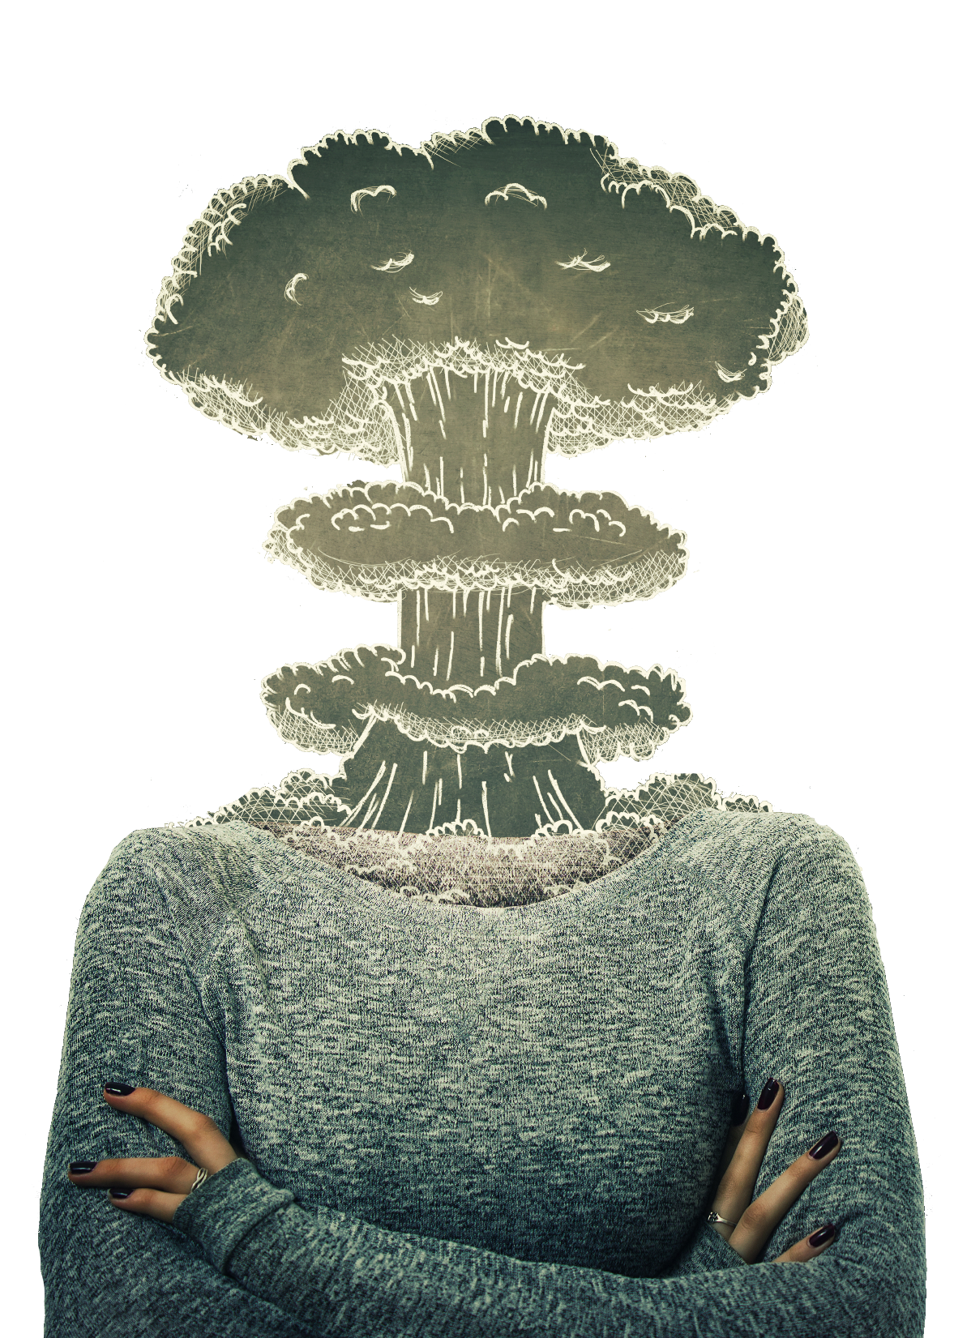
Helpful if individuals are able to identify that he/she is likely to respond to a stressful situation with extreme emotion.
Individuals should refrain from reacting to the situation until their emotions have subsided or decreased in intensity in order to promote empathic responding.
Notes:
Discussion question: Think of a situation where you might have become angry at someone for something. What were the hostile attributions you had? Then, using the same situation, think about possible non-hostile attributions/thoughts that could be had for the same situation. How does this increase/change your ability to want to be empathetic towards the individual?

Slide 11
Centering practices, mindfulness activities, and deep breathing can lessen the effect of the sympathetic nervous system to engage in a flight or fight response, and strengthen the effect of the parasympathetic nervous system which supports an empathetic state of mind.
Notes:
Activity: Chair yoga; positive psychology mindfulness exercises

