Slide 1
E
U N D E R S T A N D I N G
E M P A T H Y
MODULE 2.1
The Development of Empathy in Children

Slide 2

Development of Empathy

Slide 3
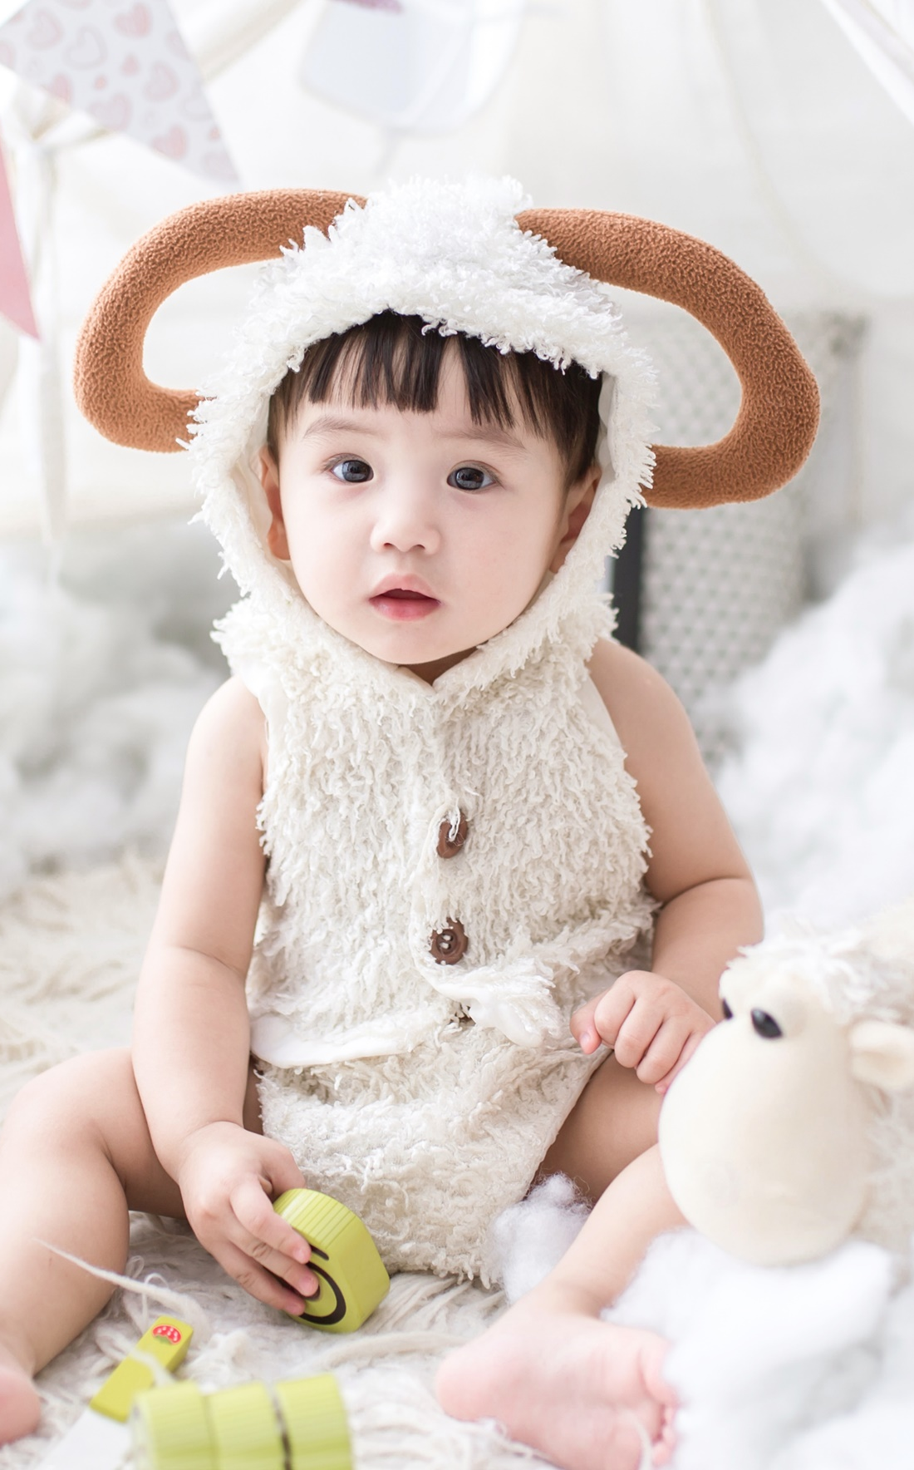
Capacity for empathy begins developing in infancy and continues into adulthood (it’s never too late!).
By 4 months of age babies start to notice differences in emotion expressions and children can begin to understand emotion complexities during the preschool years.
Children begin to comfort others in distress around 12 months of age and increase their helping behaviors in response to others’ needs between 12-24 months.

Slide 4

Constitutional Differences in Empathy

Slide 5

Genetic/biological predispositions affect capacity for empathy:
Emotional reactivity/temperament
Oxytocin
HPA Reactivity

Slide 6

Adults’ Role – Responsive Caregiving

Slide 7

Adults can create supportive, and warm environments that foster secure attachments for their children.
Children who have secure attachments learn how to regulate their own distressing emotions through interactions with their caregivers.
Children with secure attachments are more likely to care for others because of the care they have experienced in life.

Slide 8

Adults’ Role – Emotion Socialization

Slide 9
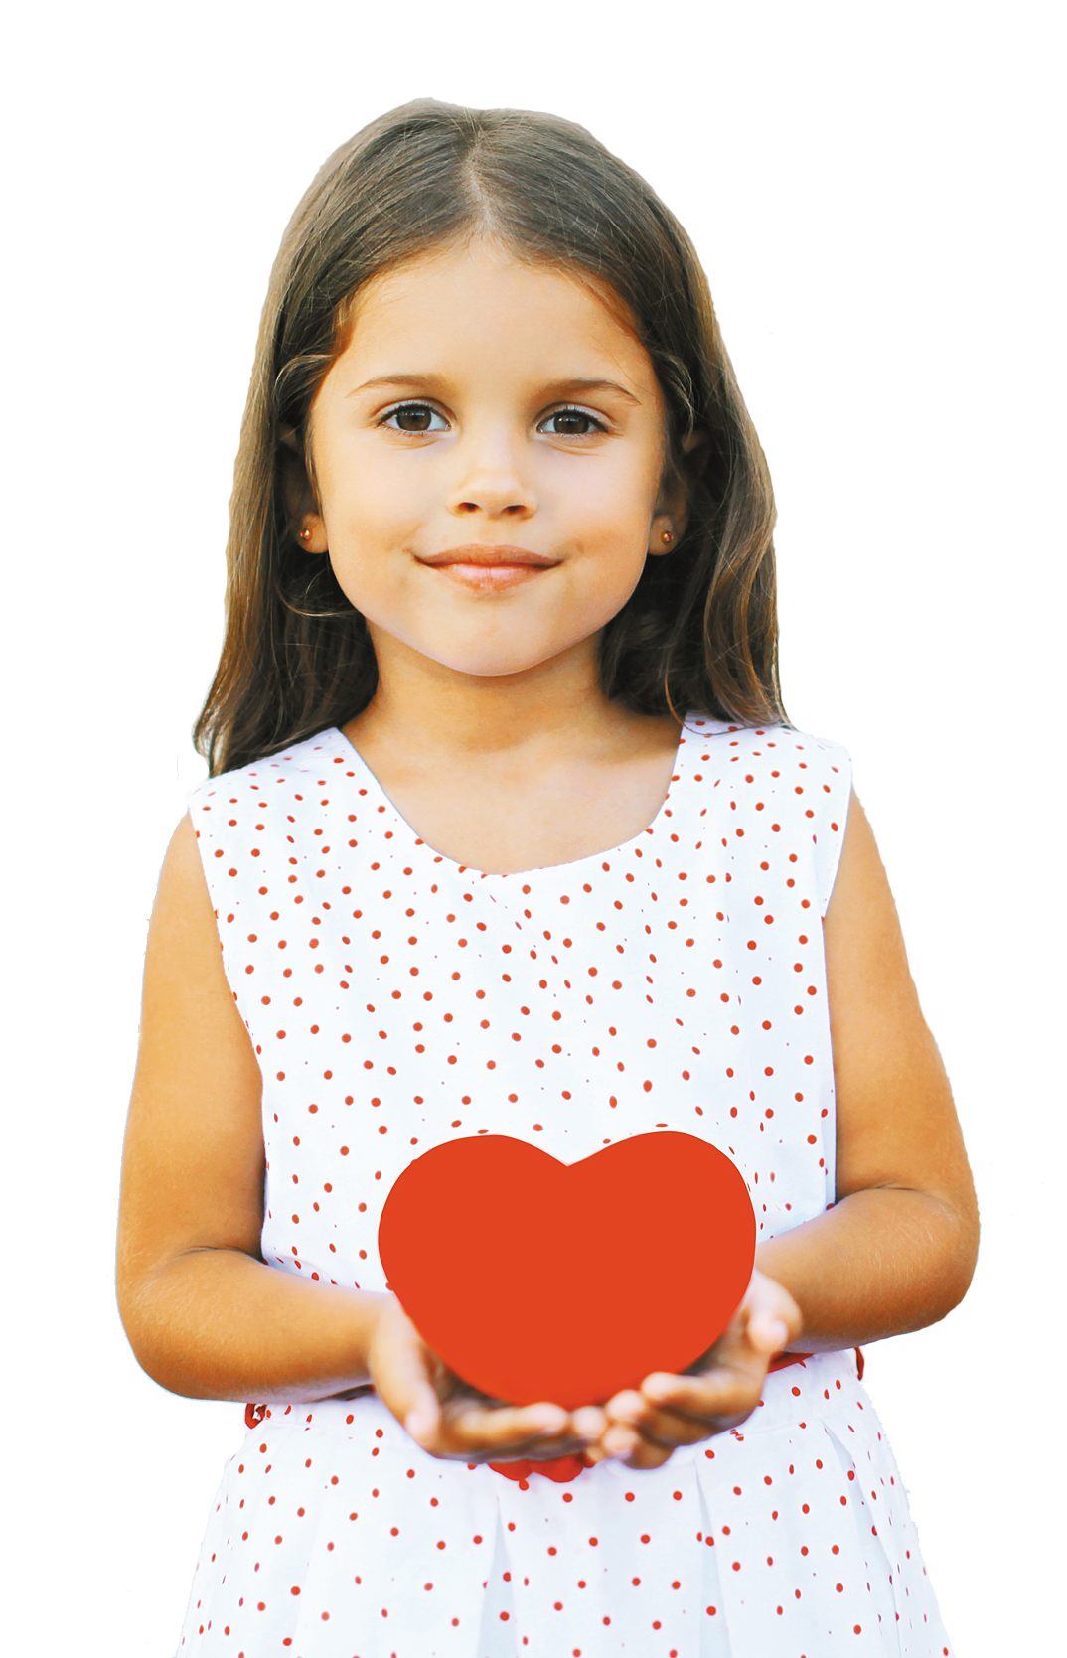
Increasing children’s knowledge about emotions and emotion regulation capacity.
Encourage the expression of children’s emotions and validate children’s feelings.
Label emotions and encourage children to notice the causes and consequences of emotions.
Model appropriate emotion regulation strategies by practicing these strategies themselves and by helping children engage in emotion regulation strategies when children are distressed.
Notes:
Discussion Questions
Describe a situation where a non-familial relationship could be critical to foster a child’s empathy development. What would this look like?
Reflect on the many different relationships that can influence empathy. In your own experience, how did these relationships influence your empathy development? You may want to think about relationships with parents, siblings, family members, teachers, etc.
In your present and future opportunities to interact with children, how can you foster empathetic behavior and good self-care practices that promote an empathetic life?
Knowledge Check
Give an example of one biological and one environmental factor that contributes to the development of a child’s empathy.

