Slide 1
E
U N D E R S T A N D I N G
E M P A T H Y
MODULE 1.3
Importance of and Measuring Empathy

Slide 2
Importance of Empathy

Slide 3
Being empathetic allows us to better predict how others may act in the future due to sharing their emotional and motivational state.
One’s ability to empathize with another may increase the emotional bond between the two individuals, resulting in elevated social interactions.

Slide 4
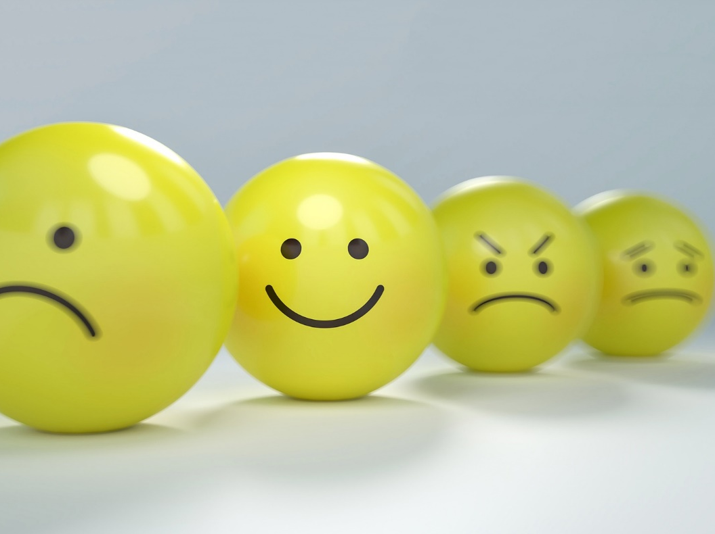
Empathy can be evident in the presence of both negative and positive emotions.
Empathetic behaviors and thinking is applicable in multiple domains. In addition to treating our fellow humans with empathy, animals and the natural environment can also be treated with empathy.

Slide 5
Measuring Empathy

Slide 6
Empathy can be operationally defined a multitude of ways, thus it is important that the choice of measurement aligns with one’s operational definition.
Approaches to the measurement of empathy include self-report, observational, and physiological approaches.

Slide 7
Self-report
Self-report measures require that the individual is able to both identify and accurately report their feelings and differentiate empathy from other emotions.
Observational
Focuses on the subjects’ actions and verbalizations. Observational measures are often favored by researchers as they may be more objective because the subject is not being asked to report on themselves.
Physiological
fMRI and EEG techniques provide insight into the neural processes of empathy by localizing empathetic responses in the brain (fMRI) and by characterizing the neural timing of empathetic responses in reaction to a stimulus (EEG).

