Slide 1
Things to
be Thankful
for Today

Slide 2
C
Cultivating
Compassion
Looking forward: Sustaining your compassionate mind
Chapter 26

Slide 3
Today’s Agenda
Things to be Thankful for Today
Sustaining our compassion
Compassion setbacks
Loving-kindness meditation
Looking forward…

Slide 4
Sustaining our Compassionate Minds

Slide 5
Preventing and Coping with Compassion Setbacks

Slide 6
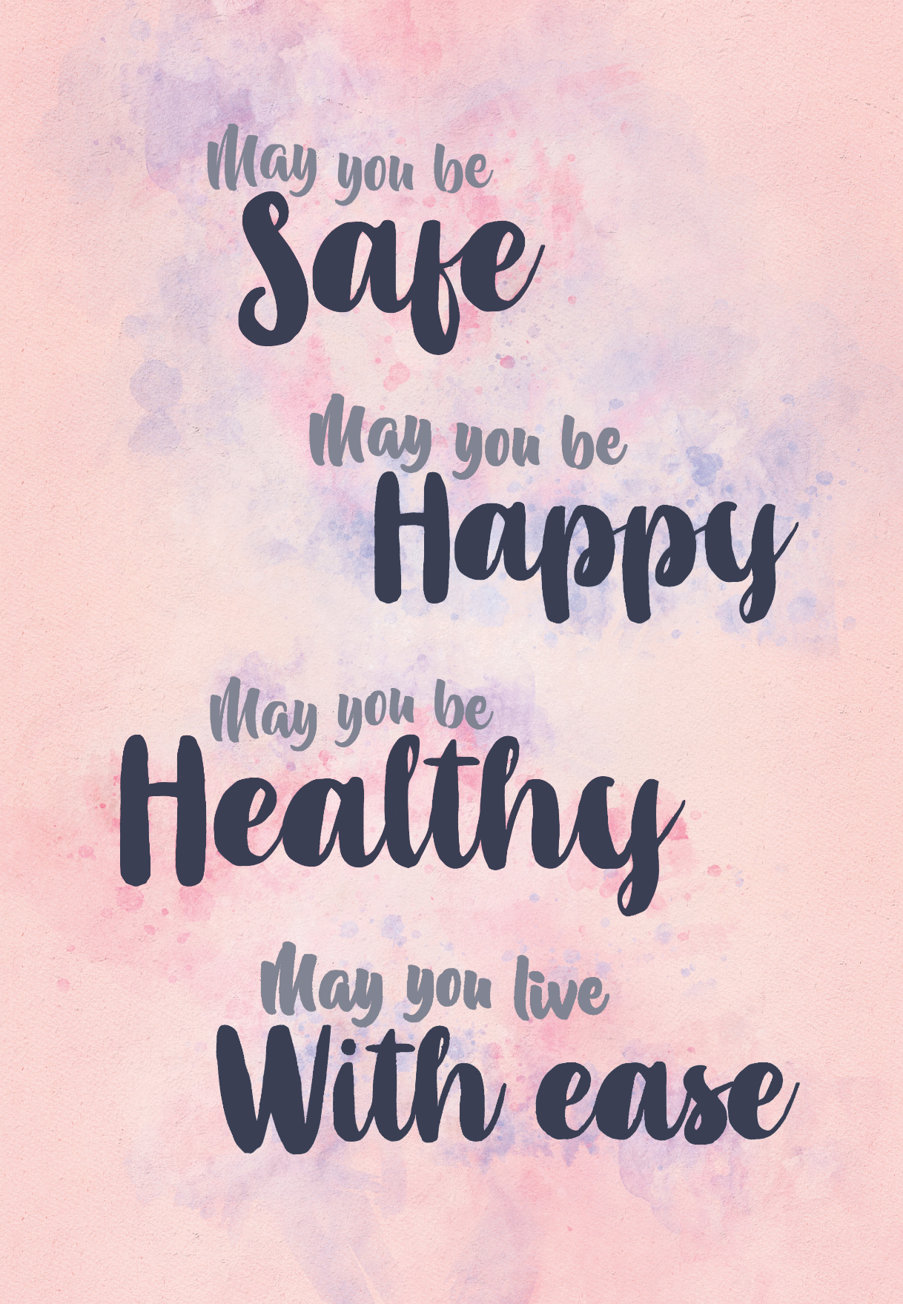
Loving-Kindness Meditation
Notes:
Instructor Notes:
Loving-Kindness Meditation

Slide 7
Looking forward to the future…
Stay in touch

