Slide 1
Things to
be Thankful
for Today

Slide 2
C
Cultivating
Compassion
Putting your compassionate mind to work with common difficulties:
Managing fears, blocks, resistances
Chapter 25

Slide 3
Today’s Agenda
Things to be Thankful for Today
Loving-kindness meditation
Fears, blocks, resistances
Dealing with common difficulties
Does everyone deserve compassion?
Notes:
Instructor Notes:

Slide 4
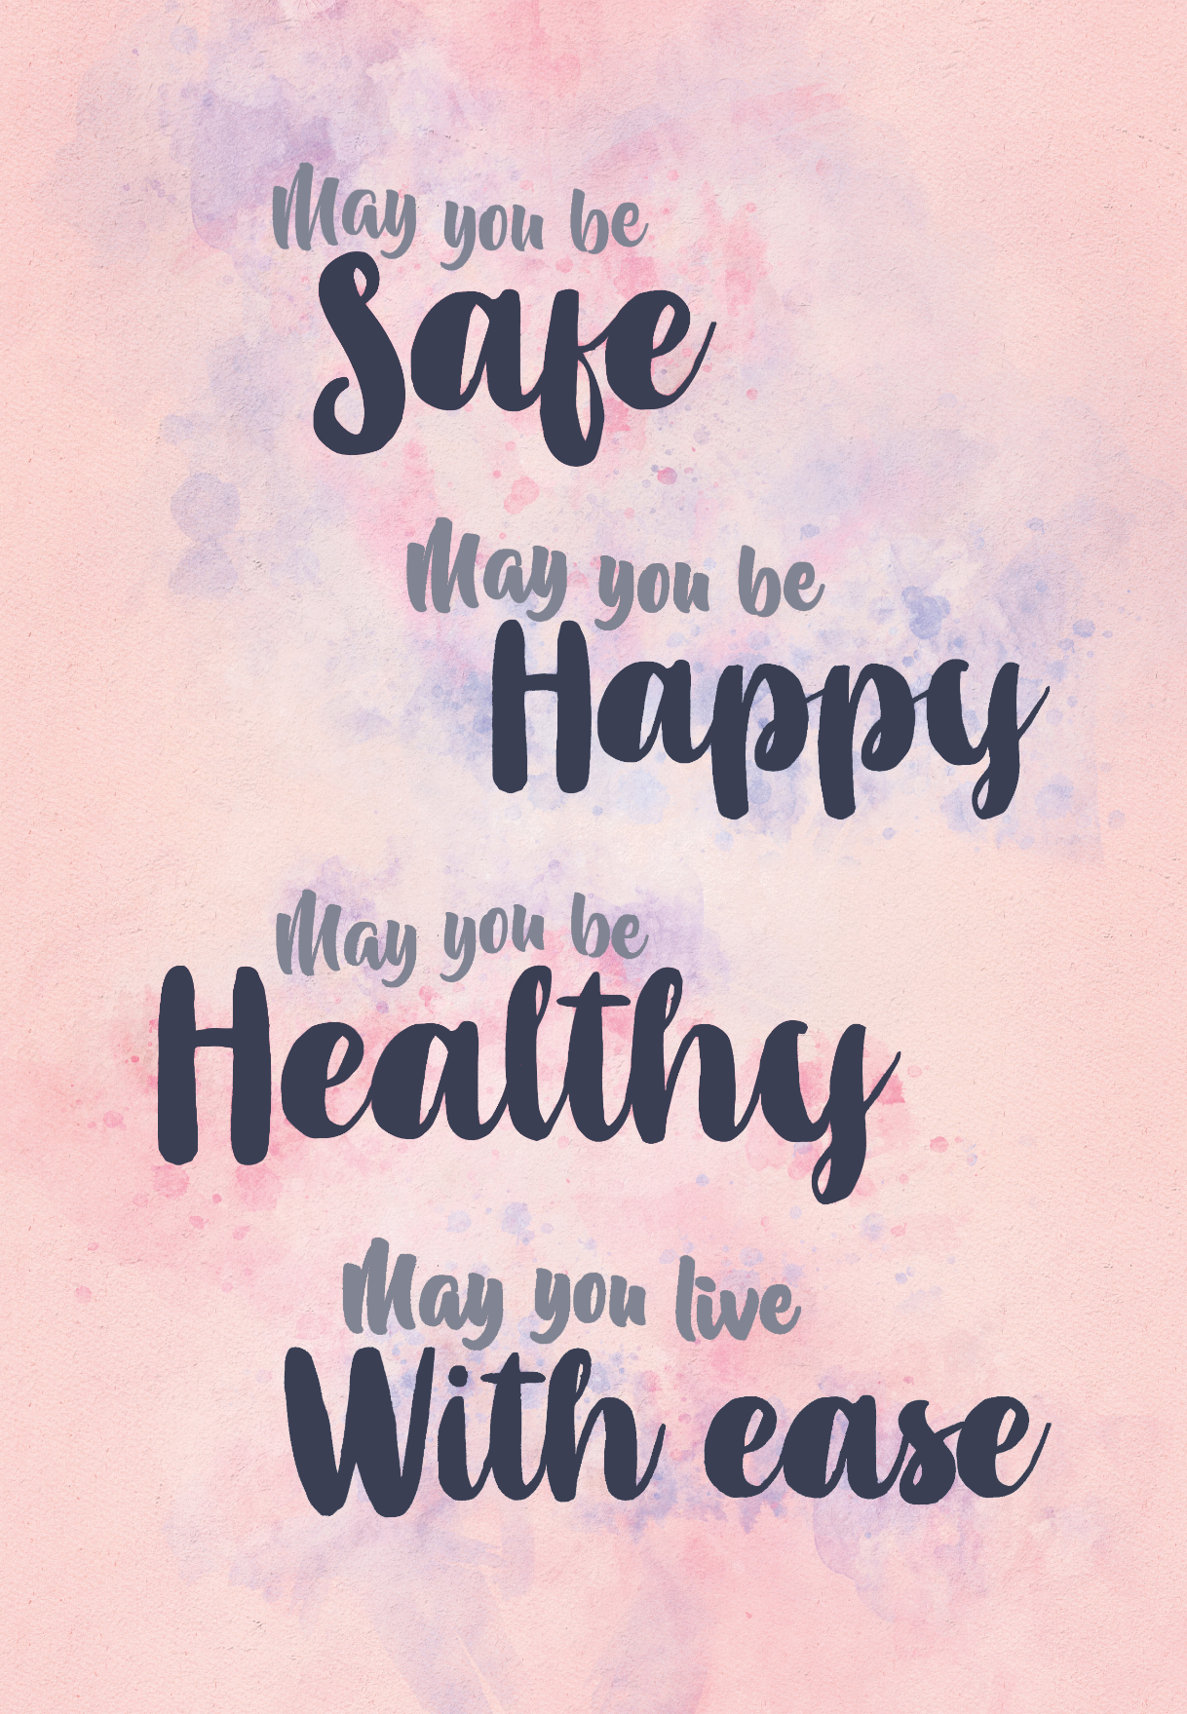
Loving-Kindness Meditation
Notes:
Instructor Notes:
Loving-Kindness Meditation

Slide 5
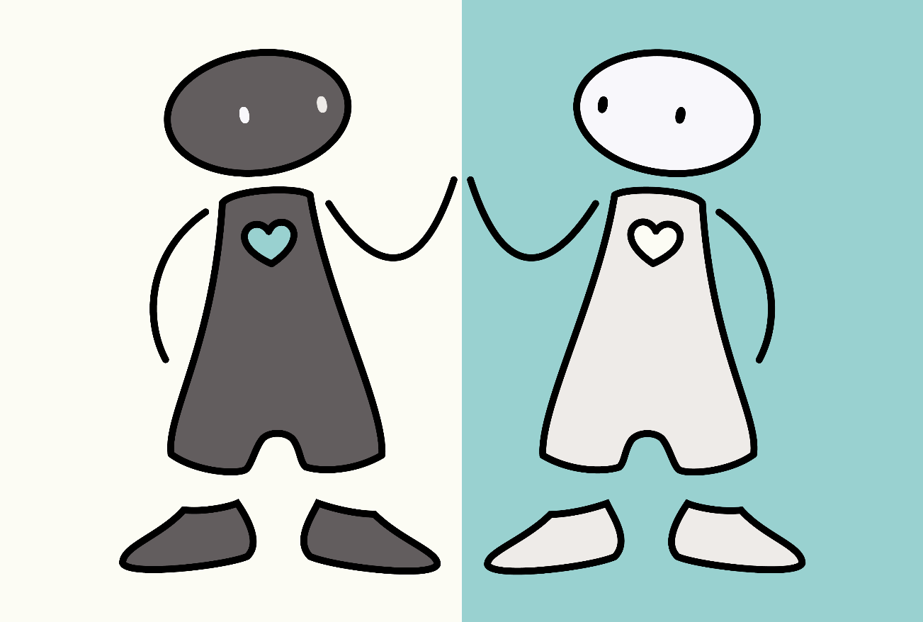
Compassion can be hard sometimes…
Fears
Blocks
Resistances
Notes:
Instructor notes:
This slide was used in Ch 7 lecture, so we’ll just review quickly.
Fears – when we would like to be compassionate, but we’re frightened of the feelings that arise when we try or we worry what might happen to us if we try to be more compassionate (worries about being too weak).
Blocks – when people would like to be compassionate and are not frightened by it, but things get in the way (too busy etc)
Resistances – simply don’t want to engage in compassion; are resistant to being compassionate to ourselves if we feel we don’t deserve it or resistant to people we feel brought on their suffering by their own actions.
Connect to the Fears of Compassion Questionnaire that students completed

Slide 6
Managing common difficulties with compassion
Weak
Indulgent
Consider origin of thought
Recall definition of compassion
Question what system is underneath (e.g., threat or drive)
Pay attention to different forms of compassion
Practice, taking small steps
Not deserved
Unfamiliar
Painful memories

Slide 7
Compassionate Ladder
Example of Compassionate Mind Training Skills
Ladder
Ideal Compassionate Other
Compassionate Self
Compassionate Memory
Safe Place Imagery
Soothing Breathing
Mindfulness Exercises

Slide 8
Does everyone deserve compassion?

