Slide 1
Things to
be Thankful
for Today

Slide 2
C
Cultivating
Compassion
Putting your compassionate mind to work with common difficulties:
Shame and self-criticism
Chapter 24

Slide 3
Today’s Agenda
Things to be Thankful for Today
Loving-kindness meditation
Shame, guilt, self-criticism
Shame resilience
Speak your shame
Self-compassion break

Slide 4
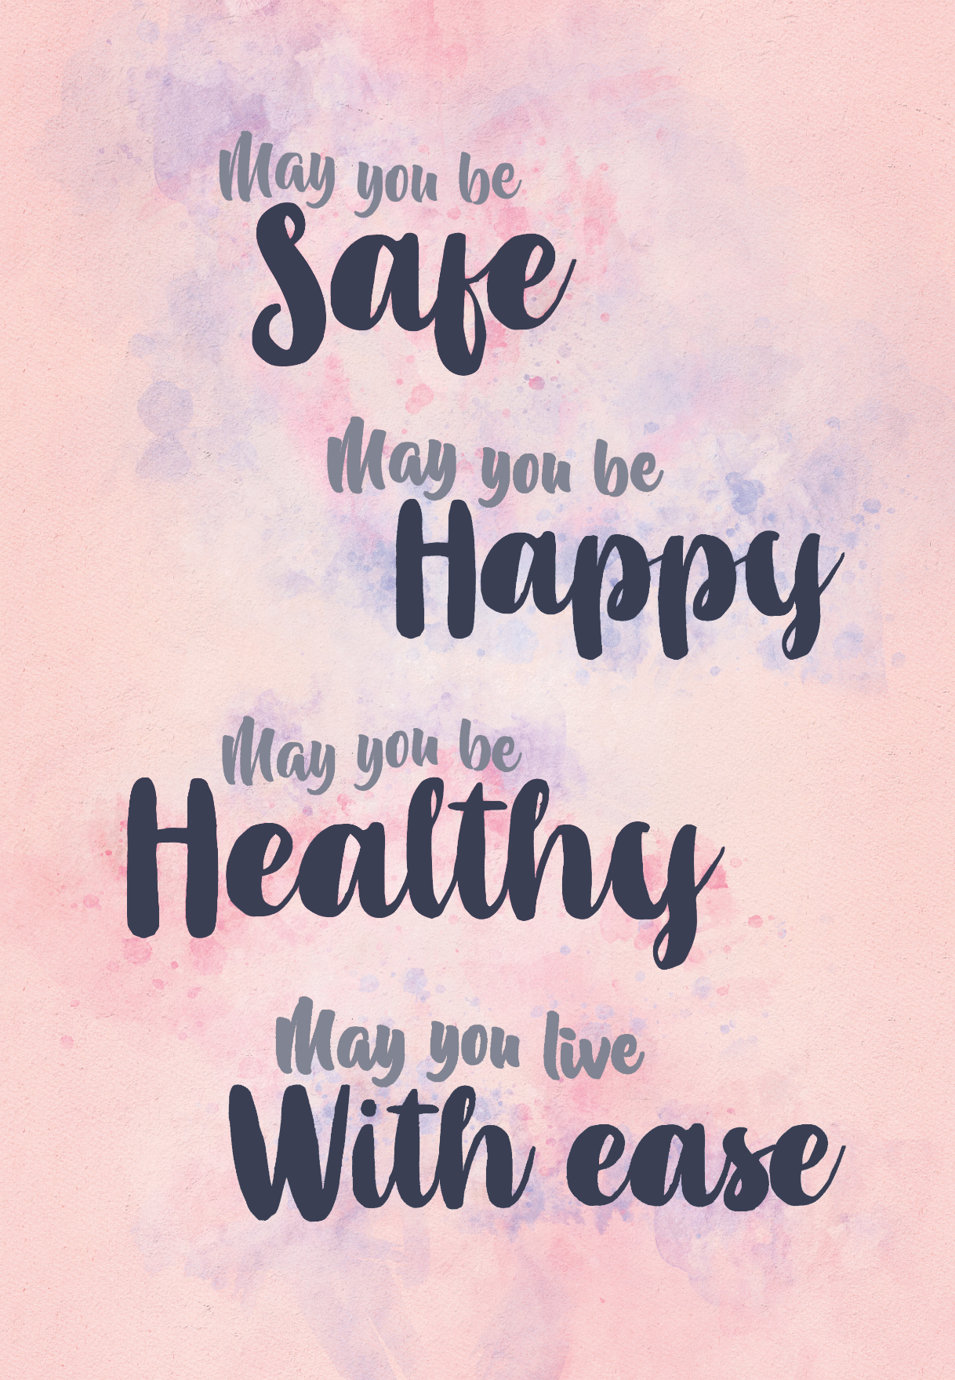
Loving-Kindness Meditation
Notes:
Instructor Notes:
Loving-Kindness Meditation

Slide 5
Shame
A social emotion in which we feel that other people hold us in a negative light, and we feel inadequate, inferior, or defective in some way.

Slide 6
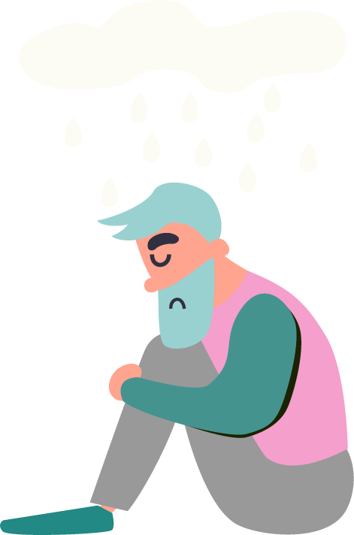
Dr. Brene Brown: Why guilt is better than shame
Notes:
Instructor Notes:
Dr. Brene Brown: Why guilt is better than shame
http://www.oprah.com/own-super-soul-sunday/dr-brene-brown-why-guilt-is-better-than-shame-video (2:56)

Slide 7
Shame vs. Guilt
Shame
I am bad
Guilt
I did something bad
Notes:
Instructor Notes:
Distinguish between shame and guilt

Slide 8
Listening to shame–Brene Brown
Notes:
Instructor Notes:
Listening to shame – Brene Brown
https://youtu.be/psN1DORYYV0 (20:38)

Slide 9
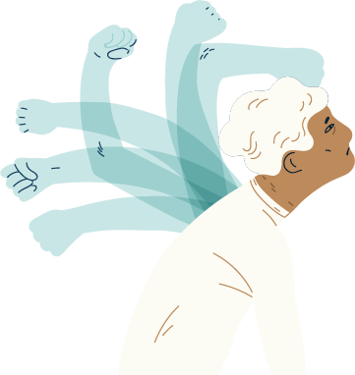
External vs. Internal
External Shame
Shame that focuses on what other people think about us
Internal Shame
Shame that focuses on our own thoughts and feelings about ourselves
Often comes with self-criticism, self-attack, or even self-hate

Slide 10
Self-criticism
Focus
General appearance
Characteristics
Aspects of our personality
Directed to our mistakes
Comparisons with others
Content
What words are used?
Form
Feeling inadequate/not good enough
Disgust/anger with desire to punish self

Slide 11
Self-criticism
Image and emotion
What your self-criticism would look, sound and feel like?
Naming/describing your critical mind
Function
What is the purpose of your self-criticism?

Slide 12
Alfred & Shadow – A short story about self-criticism
Notes:
Instructor Notes:
Alfred & Shadow – A short story about self-criticism
https://youtu.be/VP7R_WIm6-M (5:26)
-painful, feel lonely and ashamed of who I am
-need you to tell me when I actually do something bad; not helpful when criticize everything all the time

Slide 13
Shame Resilience
Change the self-talk and believe it
Talk to yourself like you’d talk to a friend
Move from shame-based self-criticism to compassionate self-correction
Vulnerability & Connection
Speak your shame
Compassion (& Empathy)
From others
From self (self-compassion)

Slide 14
Speak your Shame
Practice being vulnerable and share something that you feel shame about.
Notes:
Instructor Notes:
“Shame needs three things to grow exponentially in our lives: secrecy, silence, and judgment.” By keeping quiet, Brown says your shame will grow exponentially. “It will creep into every corner and crevice of your life,” she says. The antidote, Brown says, is empathy. She explains that by talking about your shame with a friend who expresses empathy, the painful feeling cannot survive. “Shame depends on me buying into the belief that I’m alone,” she says.
Here’s the bottom line: “Shame cannot survive being spoken,” Brown says. “It cannot survive empathy.”

Slide 15
Self-Compassion Break
This is a moment of suffering.
This hurts. This is stress.
Suffering is a part of life.
I am not alone, others feel this way.
May I be kind to myself in this moment.
It’s gonna be OK.
Mindfulness
Common Humanity
Self-Kindness
Notes:
Instructor notes:
Audio recording of Neff’s Self-compassion break (about 5min)
http://self-compassion.org/wp-content/uploads/2015/12/self-compassion.break_.mp3
Encourage students to choose their own phrases; only 1 phrase is needed per dimension of self-compassion

