Slide 1
Things to
be Thankful
for Today

Slide 2
C
Cultivating
Compassion
Putting your compassionate mind to work with common difficulties:
Multiple selves
Chapter 23
Notes:
CMW Ch. 23

Slide 3
Today’s Agenda
Things to be Thankful for Today
Breath awareness practice
Multiple selves activity
Loving kindness meditation

Slide 4
Notes:
Breath awareness practice

Slide 5
Multiple Selves Activity

Slide 6
How does your compassionate self relate to your other emotional selves?
For example…
Angry self
Anxious self
Sad self
Shameful self
Jealous self

Slide 7
Our compassionate self may be helpful in understanding, supporting, and guiding our other emotional selves. How do you find this to be true or not true for you?

Slide 8
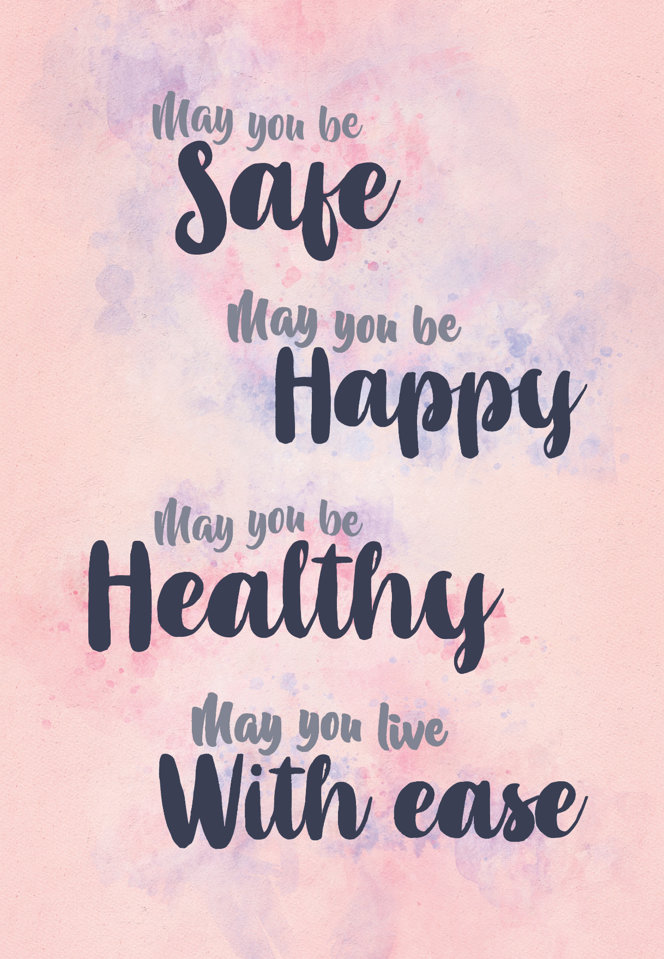
Loving-Kindness Meditation
Notes:
Instructor Notes:
Loving-Kindness Meditation

