Slide 1
Things to
be Thankful
for Today

Slide 2
C
Cultivating
Compassion
Putting your compassionate mind to work with common difficulties:
Compassionate fatigue & Self-care
Notes:
Instructor Notes:
Potential Reading:
https://www.goodtherapy.org/blog/the-cost-of-caring-10-ways-to-prevent-compassion-fatigue-0209167

Slide 3
Today’s Agenda
Things to be Thankful for Today
Loving-kindness meditation
Compassion fatigue
Vicarious trauma
Burnout
How to manage compassion fatigue
Self-care

Slide 4
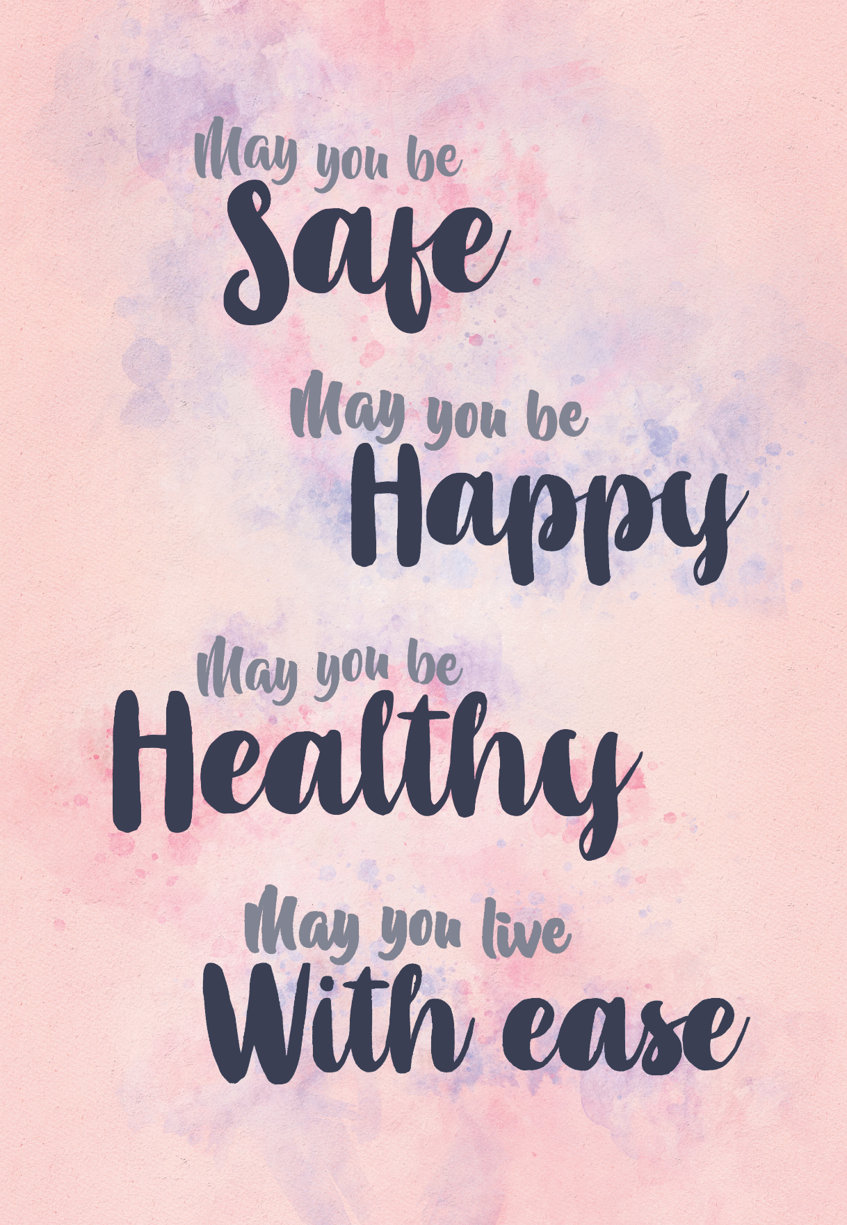
Loving-Kindness Meditation
Notes:
Instructor Notes:
Loving-Kindness Meditation

Slide 5
Compassion Fatigue
Physical and emotional exhaustion and a profound decrease in the ability to empathize that can occur when caregivers/helpers are exposed to suffering of people or animals, but unable to refuel.
Notes:
Instructor Notes:
Professional caregivers exist in a variety of professions:
First Responders (police, firefighters)
Health-Care Workers (doctors, nurses, EMT/paramedics, nursing home)
Criminal Justice System (lawyers, judges, parole officers)
Social Workers
Psychologists/Therapists/Counselors
Teachers
Animal Welfare Worker (shelter, rescue, veterinarian)
Caregivers for family/friends
https://www.goodtherapy.org/blog/the-cost-of-caring-10-ways-to-prevent-compassion-fatigue-0209167

Slide 6
Vicarious Trauma
Repeated exposure to the traumatic experiences of others can cause a profound shift in world-view that occurs in helping professionals when they work with clients/patients who have experienced trauma.
Notes:
Instructor Notes:
Compassion fatigue is a form of secondary traumatic stress – the stress occurs as a result of helping or wanting to help those who are in need

Slide 7
Burnout
Physical and emotional exhaustion that workers can experience when they have low job satisfaction and feel powerless and overwhelmed at work.
Cumulative process
Not trauma-related
May or may not co-exist
with change in world-view
or reduced compassion.
Notes:
Instructor Notes:
Burnout is a term that has been used since the early 1980s describe the physical and emotional exhaustion that workers can experience when they have low job satisfaction and feel powerless and overwhelmed at work. However, burnout does not necessarily mean that our view of the world has been damaged, or that we have lost the ability to feel compassion for others.
Most importantly, burnout can be resolved: changing jobs can provide immediate relief to someone suffering from job-related burnout. This is not the case for CF and VT. Helpers can simultaneously experience Compassion Fatigue and Vicarious Trauma. They are cumulative over time and evident in our personal and professional lives. They are also an occupational hazard of working in the helping field. (Saakvitne & Pearlman, 1996)
As a helping professional, the distinction described above may not be particularly important to make. It is only important in so far as it helps you understand the contributing factors that lead to developing CF or VT. As well, the more that we know about the problem, the more able we are to develop strategies to prevent/modulate the impact of what we experience.

Slide 8
How to manage compassion fatigue in caregiving
Notes:
Instructor Notes:
How to Manage Compassion Fatigue in Caregiving | Patricia Smith | TEDxSanJuanIsland
https://youtu.be/7keppA8XRas (17:36)
Notes from video:
How to Manage Compassion Fatigue in Caregiving | Patricia Smith
-taking on the pain and suffering of the wounded warriors
-compassion fatigue affecting quality of life
-on a road to wellness; we’re integrated beings
-why do some people suffer from CF and others don’t? What are the symptoms?
-“CF is a state experienced by those helping people or animals in distress; it is an extreme state of tension and preoccupation with the suffering of those being helped to the degree that it can create a secondary traumatic stress for the helper.”
-symptoms include:
-we want to isolate (because someone is always asking something of/from us; we don’t have anything left to give; we’re fairly depleted)
-the rhythm of a healthy caregiver is fill up, empty out, fill up, empty out; well, if we deplete, deplete, deplete
-(other) set of symptoms include:
-emotional outbursts (comes from not learning adaptive coping skills during formative years; learned to push everything down in order to deal with our lives if there was trauma and pain and suffering in our early lives; we push it down until the human body says enough and it comes out as an emotional outburst)
-physical ailments (stress points of human body; body saying ‘stop, you’re hurting me’)
-them vs. us mentality (healing is an inside job)
-sadness and apathy (because we’re not living our full quality of life)
-flashbacks and recurring nightmares (help from a mental health professional)
-CF is fixable
-patterns begin in early childhood
-other-directedness (learn that it’s more important to take care of others before ourselves; when we try to take care of ourselves, we have feelings of shame and self-centeredness and selfishness – we have to overcome this; if we don’t fill ourselves up, we won’t have anything left to give)
-lack of strong personal boundaries (we let everything and everyone into our lives and it can be hurtful; journey to wellness includes practicing good boundaries, we decide what we will and won’t allow in our lives)
-unresolved past pain and trauma (we have to learn ways to let go of the trauma that we’ve experienced)
-overdeveloped sense of responsibility
-impulse to rescue anyone in need
-Where do we start? How do we start? How do we lift our quality of life so that we’re happy, healthy human beings?
-we start by making a self-care plan
-on the road to healing….
-authentic, sustainable self-care (time with ourselves)
-empathic discernment (learn what hurts us and protect self)
-ask for help
-strengthen resiliency
-balanced life (fill up, empty out)
-embrace spirituality (doesn’t need to be traditional)
-be mindful (being 100% present in whatever we’re doing)
-be grateful

Slide 9
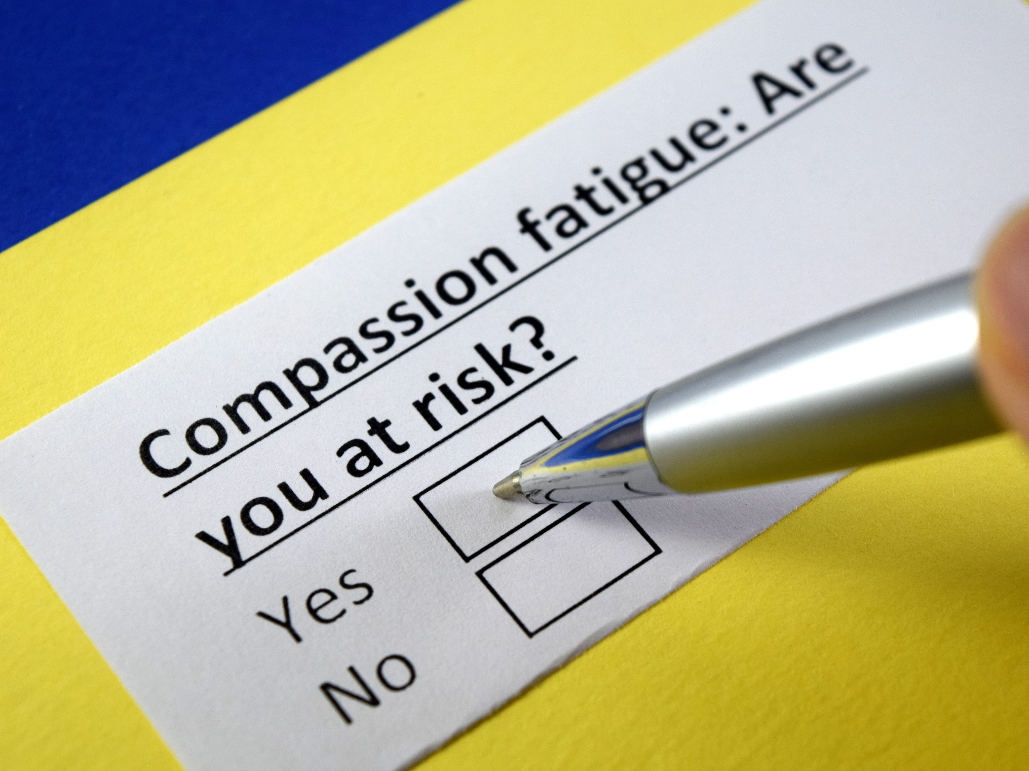
Compassion Fatigue
Notes:
Because it can arise so abruptly, it’s important for those working in caring/helping professions (especially) to protect themselves; Knowing the signs and symptoms and continuing to check in with yourself can help you better prevent and manage compassion fatigue if it arises
What are some of the signs of compassion fatigue and vicarious trauma?
Researchers have discovered that helpers, when they are overtaxed by the nature of their work, begin to show symptoms that are very similar to their traumatized clients. These symptoms can negatively affect the workplace and create a toxic work environment.
Difficulty concentrating
Intrusive imagery
Feeling discouraged about the world
Hopelessness
Exhaustion and irritability
High attrition (helpers leaving the field)
Negative outcomes (dispirited, cynical workers remaining in the field, boundary violations)
The most common signs and symptoms of compassion fatigue include:
From Good Therapy website
Chronic exhaustion (emotional, physical, or both)
Reduced feelings of sympathy or empathy
Dreading working for or taking care of another and feeling guilty as a result
Feelings of irritability, anger, or anxiety
Depersonalization
Hypersensitivity or complete insensitivity to emotional material
Feelings of inequity toward the therapeutic or caregiver relationship
Headaches
Trouble sleeping
Weight loss
Impaired decision-making
Problems in personal relationships
Poor work-life balance
Diminished sense of career fulfillment
Believe it or not, these are all helpful, as they quickly alert us to our depleted state. If we are paying attention and are committed to radical self-care, we can act on this awareness by rebalancing our life. If that is not possible, simply taking short breaks throughout the day to close your eyes, focus on your breath, or put your hands on your heart and send yourself some compassion can all make a big difference
What factors contribute to CF/VT and Burnout?
The Individual:
Your current life circumstances, your history, your coping style and your personality type all affect how compassion fatigue may impact you.
Most helpers also have other life stressors to deal with. Many are in the “sandwich generation” – meaning that they take care of both young children and aging parents in addition to managing a heavy and complex workload. Helpers are not immune to pain in their own lives and, in fact, some studies show that they are more vulnerable to life changes (such as divorce and addictions) than people who do less stressful work.
The Situation:
Helpers often do work that other people don’t want to hear about. They spend their time caring for people who are not valued or understood in our society. This may include individuals who are homeless, abused, incarcerated or chronically ill.
Furthermore, our working environments are often stressful and fraught with workplace negativity. This negativity is often a result of individual compassion fatigue, burnout and general unhappiness. The work itself is also very stressful. Dealing with clients/patients who are experiencing chronic crises, who have difficulty controlling their emotions, and/or those who may not get better can be draining.
Finally, we live in a society that glamorizes violence and does not adequately fund efforts to reduce or prevent violence in our society.
USE POSITIVE COPING STRATEGIES
While it may be tempting to wash away the stress and emotional burdens of your job with alcohol or drugs, this can actually work in the reverse and compound stress in the long run. Consider making a list of positive coping strategies to use in times of stress. This might include deep breathing, meditation, taking a walk, talking with a friend, watching a funny movie, or relaxing in a hot bath.
We’ll talk more about self-care on Thursday

Slide 10
Stages of Compassion Fatigue
Stage 1: Zealot
Committed, enthusiastically involved and available, putting in extra hours and volunteering to help
Stage 2: Irritability
Cutting corners, disillusionment, irritability
Stage 3: Withdrawal
Experiences a loss of enthusiasm; may complain of stress fatigue or exhaustion; desire to detach; self-doubt
Stage 4: Zombie
Sleeplessness and/or hypervigilance; hopelessness can turn to rage and others seem incompetent; impatient and distant
Notes:
Instructor Notes:
5 discussed in this video: https://www.youtube.com/watch?v=unCc0DgSfDw
(Pathology vs. Renewal)
4 discussed here: http://veterinarynews.dvm360.com/compassion-fatigue-often-unavoidable-adapting-critical
https://www.slideshare.net/tcmegahan/compassion-fatigue-13324896
https://static1.squarespace.com/static/561eb23ae4b06ed190adbe45/t/57d1c48cc534a562b1437139/1473365132698/Compassion+Fatigue.pdf

Slide 11
Self-Care is…
An intentional process of tending to our mental, emotional, and physical health by choosing behaviors that balance the effects of emotional and physical stressors
Notes:
Instructor Notes:
Self-care is any activity that we do deliberately in order to take care of our mental, emotional, and physical health.

Slide 12
Self-Care is NOT…
Selfish
Self-indulgence
Self-pampering
Permission to engage in behaviors that are unhealthy or detrimental to you
Notes:
Instructor Notes:
Self-care isn’t a selfish act either. It is not only about considering our needs; it is rather about knowing what we need to do in order to take care of ourselves, being subsequently, able to take care of others as well. That is, if I don’t take enough care of myself, I won’t be in the place to give to my loved ones either.

Slide 13
Self-Care
Balanced, nutritious diet
Regular exercise
Routine schedule restful sleep
Balance of work/leisure time
Nurturing (non-work) activities
Meditation/Mindfulness
Self-compassion
Positive close relationships
Notes:
Instructor Notes:
Self-care can be a preventative measure to guard against compassion fatigue and burnout, but can also be an interventional strategy
Avoid unhealthy coping strategies (numbing yourself with drugs/alcohol etc)
Balanced, nutritious diet
Regular exercise
Routine schedule of restful sleep
Balance between work and leisure
Honoring emotional needs
Set Emotional boundaries
Meditation/Mindfulness Practices
--some people separate out Relaxation exercises such as muscle relaxation; imagery exercises
Maintain/cultivate positive connections with others

