Slide 1
Things to
be Thankful
for Today

Slide 2
C
Cultivating
Compassion
Putting your compassionate
mind to work:
Compassionate behavior &
Self-compassionate letter
Chapters 21 & 22

Slide 3
Today’s Agenda
Things to be Thankful for Today
Loving-kindness meditation
Compassionate behavior
Compassion across contexts
Confronting difficult situations
Self-compassionate letter

Slide 4
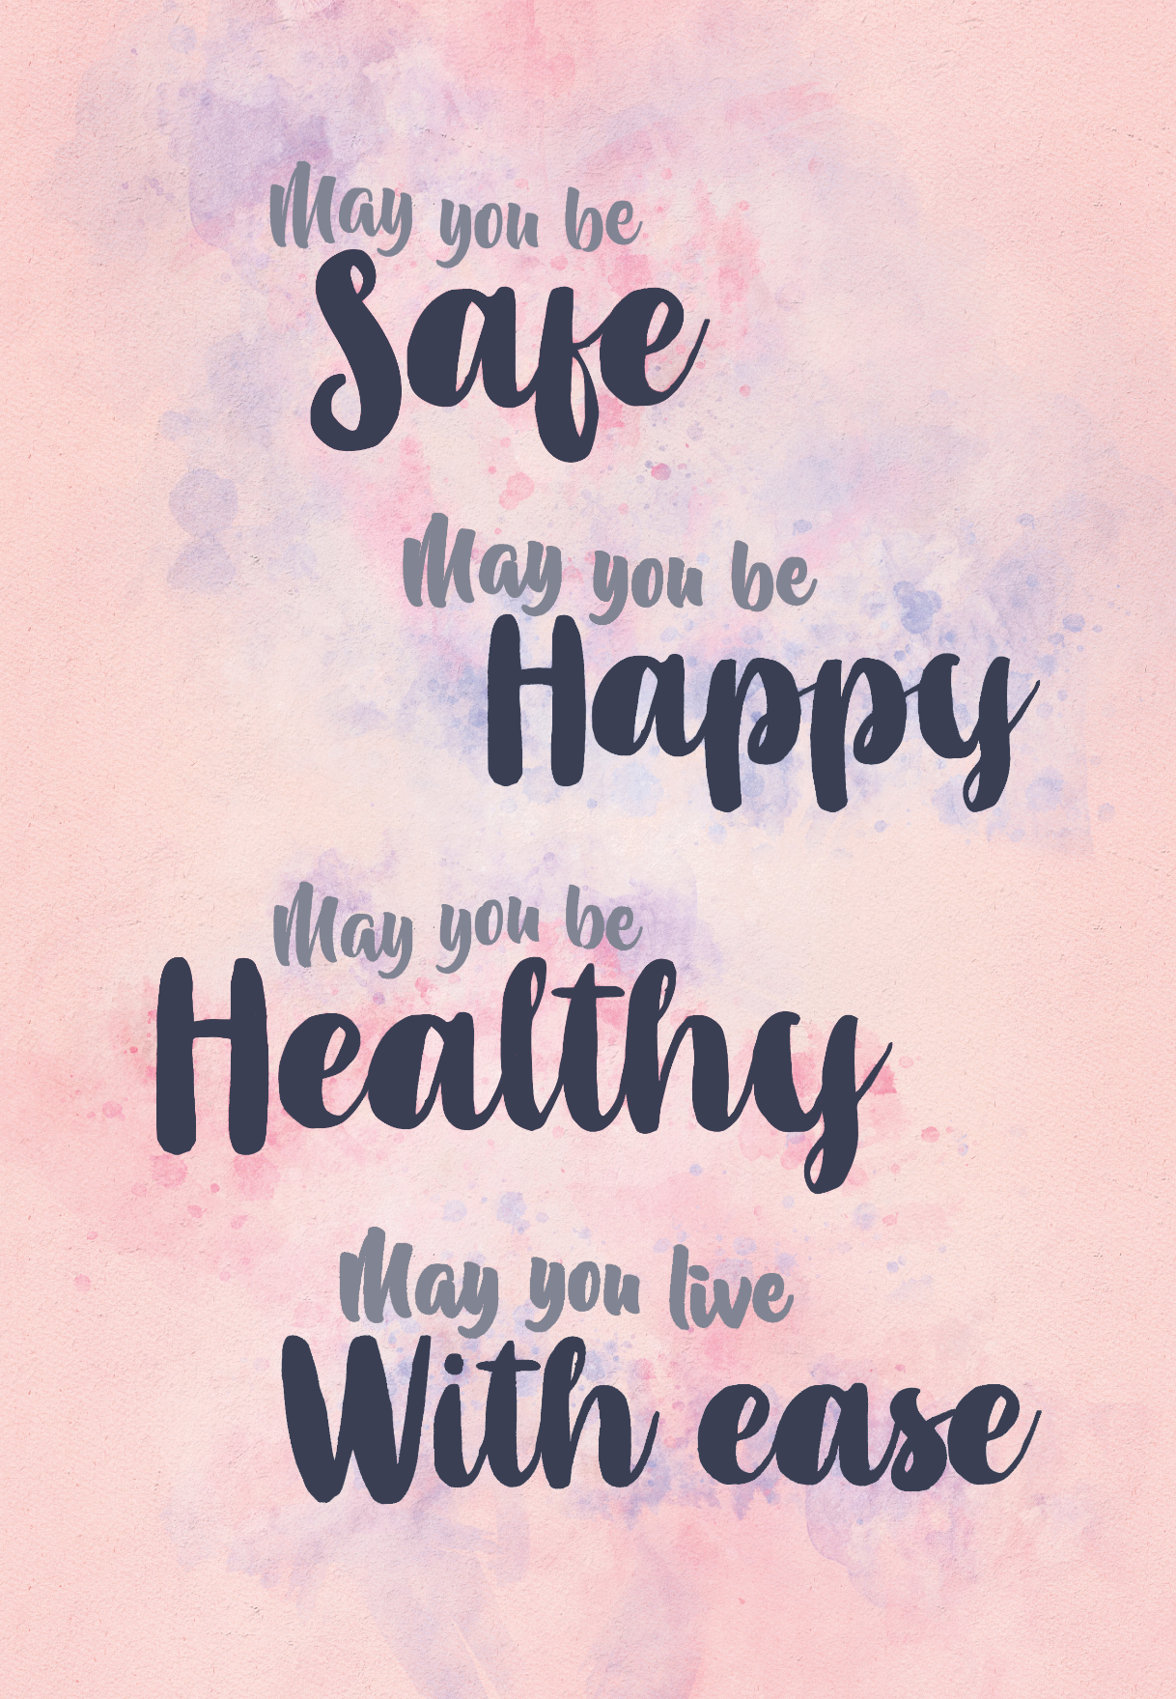
Loving-Kindness Meditation
Notes:
Instructor Notes:
Loving-Kindness Meditation

Slide 5
Compassionate Behavior…
is not just about being ‘nice’ or ‘kind’ – it involves cultivating and using qualities (caring-commitment, wisdom, and strength/courage) to act in ways that will be helpful to yourself and others..
often involves strength and courage to do things that we find difficult

Slide 6
Compassionate Behavior – across contexts
Family relationships
Parenting
Spouse
Caring for elderly parent or other family member
Friendships
Work environments
Leadership positions
Healthcare professions
Other helping professions
Community/Society
Select 3+ contexts and brainstorm compassionate behaviors
Notes:
Instructor Notes:
Let’s explore some different context that we might engage in compassionate behavior (towards others for this exercise; we’ll focus on self-compassion later) and discuss some examples or ways we tend to display compassionate behavior
It would have been helpful to spend more time discussing nuances of how behavior can look different in different contexts (e.g., family—emotional, work—instrumental support)

Slide 7
Using Compassion to Confront a Difficult Situation We Avoid
Select 1 thing you feel nervous about and tend to avoid
What are your safety/avoidance strategies?
What are you afraid might happen?
Express compassion
What is at least 1 step you could take toward facing this thing you avoid?

Slide 8
Discuss with your partner: -one thing you avoid -avoidance strategies -what you are afraid of -allow your partner to express compassion -one step toward facing it

Slide 9
Self-Compassionate Letter and Science of Self-Compassion
Notes:
Instructor Notes:
Ch 22
Another way we can put our ‘compassion into action’ is through compassionate letter writing
Episode 2: Quieting your inner critic podcast
(Discussing the Self-Compassionate Letter & the Science of Self-Compassion)
https://greatergood.berkeley.edu/podcasts/item/quieting_your_inner_critic (14:49)

