Slide 1
Things to
be Thankful
for Today

Slide 2
C
Cultivating
Compassion
Putting your compassionate
mind to work:
Compassionate engagement of emotion
Chapter 20

Slide 3
Today’s Agenda
Things to be Thankful for Today
Loving-kindness meditation
Saving Sami activity
Emotion Regulation
Turning towards difficulty

Slide 4
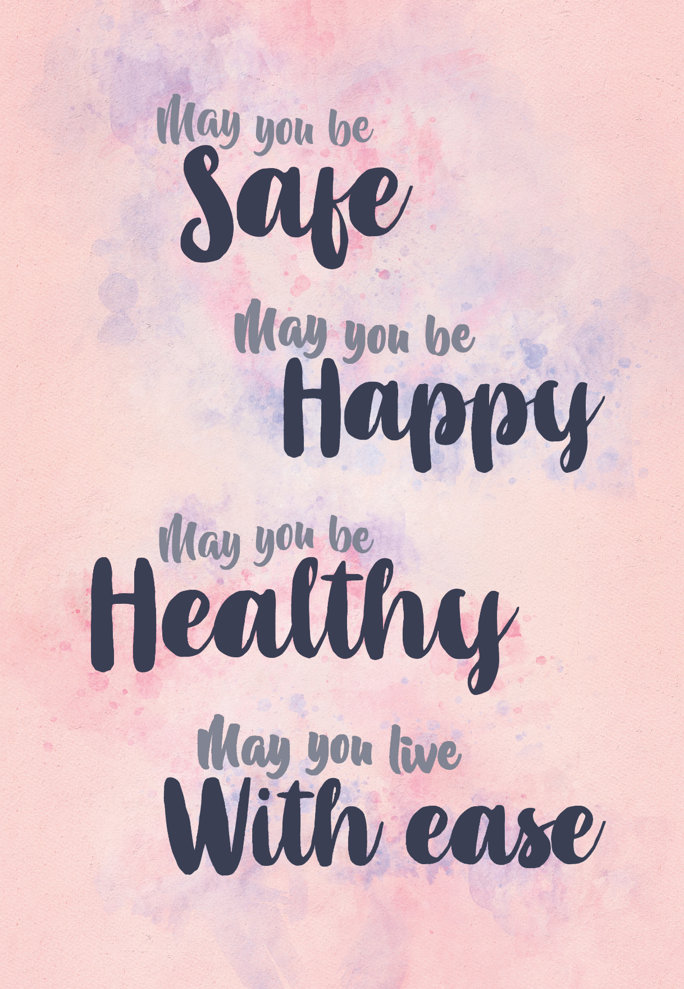
Loving-Kindness Meditation
Notes:
Instructor Notes:
Loving-Kindness Meditation

Slide 5
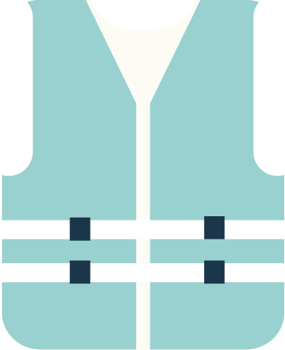
Saving Sami
Sami’s boat capsized and Sami can’t swim. Sami’s life jacket is under the boat.
Help save Sami by doing the following
Flip the boat over
Put Sami’s life jacket on
Get Sami inside the boat
Lay the oar across the top of the boat
You can only touch the paperclips
Don’t hurt Sami or the life jacket
If Sami touches the water without the life jacket on, you have to start over

Slide 6
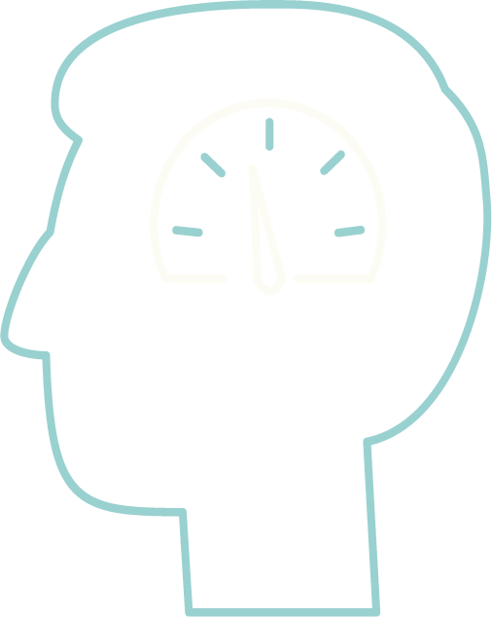
Emotion Regulation
Our attempts and ability to manage our emotions in helpful and healthy ways.
Notes:
Instructor Notes:
We can struggle with our emotions, and managing emotions, in a number of ways, including difficulties in noticing, labeling, understanding, and expressing emotions…

Slide 7
Emotion Regulation
Step 1: Noticing and identifying emotions
Notice emotion; Where in our body?; What is it urging us to do?; Is that helpful/appropriate?

Slide 8
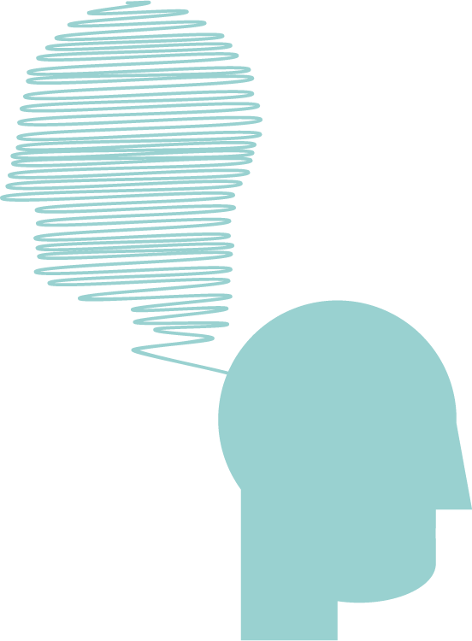
Emotion Regulation
Step 2: Making sense
of our emotions
Understanding why you are feeling this way
Don’t invalidate your feelings

Slide 9
Emotion Regulation
Step 3: Using compassionate
mind to help tolerate
your emotions
Fear of being overwhelmed by emotion
Work to tolerate difficult emotions

Slide 10
Turning towards difficulty meditation
Notes:
Instructor Notes:
15 minute guided mindfulness mediation: Turning toward difficulty mediation
https://soundcloud.com/mindfulmagazine/10-minute-guided-practice-turning-toward-difficulty

Slide 11
Emotion Regulation
Step 4: Learning to express your emotions
Managing fears related to expressing emotions

