Slide 1
Things to
be Thankful
for Today

Slide 2
C
Cultivating
Compassion
Putting your compassionate
mind to work:
Compassionate thinking
Chapter 19

Slide 3
Today’s Agenda
Things to be Thankful for Today
Loving-kindness meditation
Evolution has shaped our thinking
Threat-based
Better-safe-than-sorry
Compassionate thinking

Slide 4
I’m % present today, the rest of me is .

Slide 5
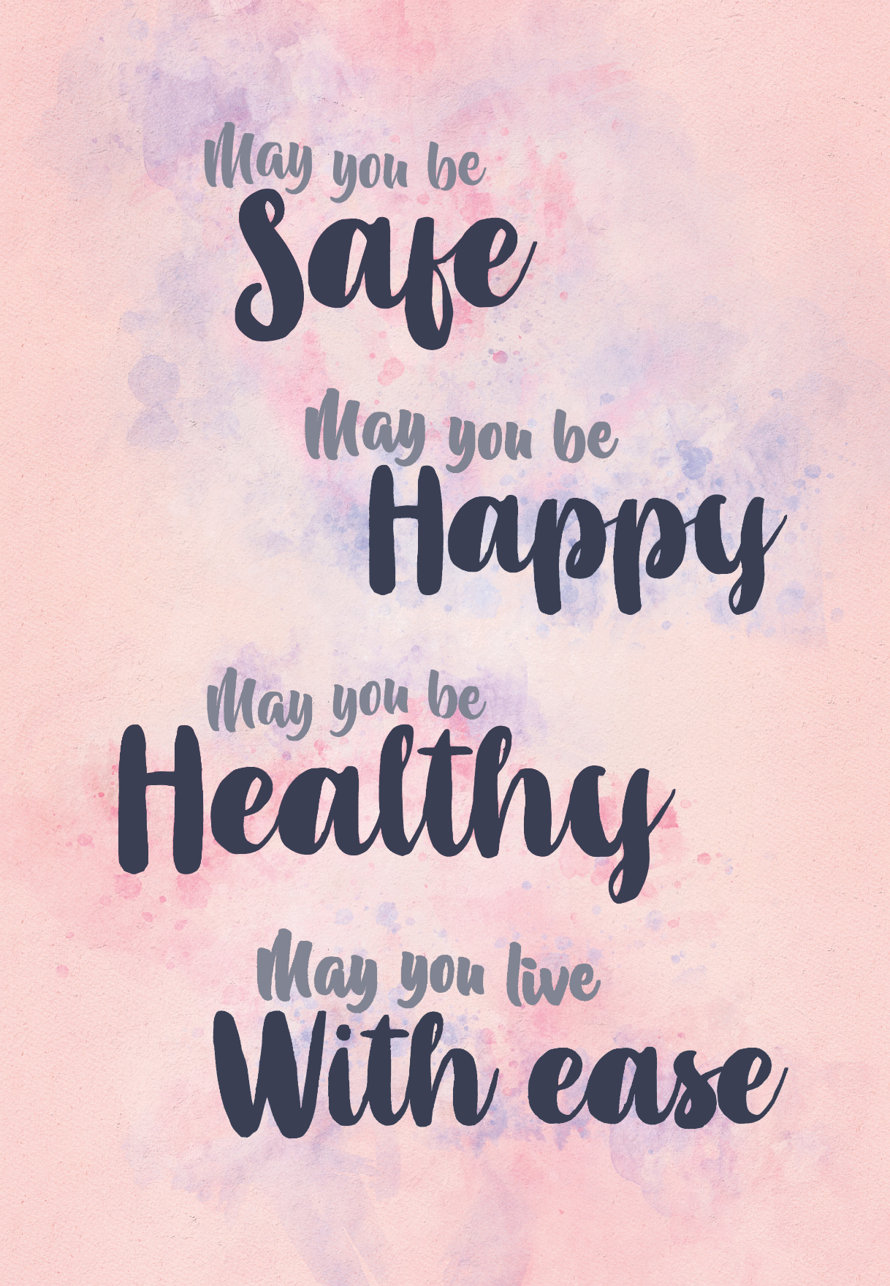
Loving-Kindness Meditation
Notes:
Instructor Notes:
Loving-Kindness Meditation

Slide 6
Evolution has shaped the way we think
Thoughts impact us
Different types of thoughts influence our emotion and behavior differently
Our thoughts are created for us
We often become aware of thoughts as the occur
Our thoughts are biased in a threat- focused way

Slide 7
Threat-based thinking
Our old-brain brings up threat feelings like anger, anxiety, and shame
This creates thinking-feeling loops in the brain

Slide 8
Better-safe-than-sorry thinking
Jumping to conclusions
Quickly forming an opinion in the absence of sufficient evidence; tending to think negatively
Overgeneralizing
One bad experience extends to all similar situations in the future
Dichotomous thinking
Seeing things as all ‘good’ or all ‘bad’

Slide 9
Share a time you thought in one of these ‘better-safe-than-sorry’ ways.
What did you think about yourself and the situation?
If another person was involved, what assumptions did you make about them?

Slide 10
Compassionate Thinking

Slide 11
Compassionate thinking exercise
Notes:
Instructor Notes:
Compassionate thinking exercise
https://youtu.be/Jj8HEIoV5us (4:38)

Slide 12
Using our compassionate mind to engage our threat-based thinking
Step 1:
Learning to notice threat-system-based thoughts and our reaction to them
Thoughts are not facts

Slide 13
Using our compassionate mind to engage our threat-based thinking
Step 2:
Bringing greater balance to our thinking
Notes:
-

Slide 14
Using our compassionate mind to engage our threat-based thinking
Step 3:
Noticing any changes in thoughts, emotions, or behaviors

Slide 15
Mindfulness dissolves thoughts
Notes:
Instructor Notes:
Mindfulness dissolves thoughts – Attention is what’s left over, with John Kabat-Zinn
https://youtu.be/LvLRheIPY90 (5:28)

Slide 16
How might compassionate thinking differ from making excuses or rationalizing our behavior?

