Slide 1
Things to
be Thankful
for Today

Slide 2
C
Cultivating
Compassion
Putting your compassionate
mind to work:
Compassionate attention
Chapter 18

Slide 3
Today’s Agenda
Things to be Thankful for Today
Loving-kindness meditation
Compassionate attention
Compassionate listening

Slide 4
I’m % present today, the rest of me is .

Slide 5
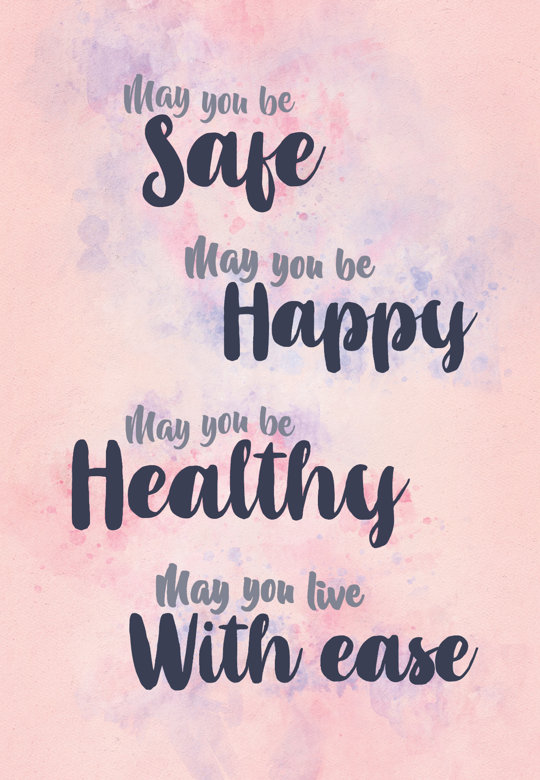
Loving-Kindness Meditation

Slide 6
Coffee Cart Compassion
Notes:
Instructor Notes:
This special ed teacher’s real-world lessons will inspire you – class act
https://youtu.be/_1dBa6f0qyk (6:23)

Slide 7
Compassionate Attention
Step 1: Paying attention to attention
Understand what is happening with our attention in the present moment
Becoming more aware of what happens to your attention

Slide 8
Compassionate Attention
Step 2: Working with attention from your compassionate mind
Learning what to pay attention to – directing attention in a compassionate and helpful way
Using our compassionate mind to see what is behind the focus of our threat attention

Slide 9
What is compassionate listening?
Notes:
Instructor Notes:
What is compassionate listening
https://youtu.be/LxAVyt9cMRQ (1:49)
-attentive listening = paying full attention to the speaker without interrupting or offering advice
-compassion = having the desire to alleviate the suffering of the speaker
-empathy = trying to understand the problems of the speaker

Slide 10
Thich Nhat Hanh on compassionate listening
Notes:
Instructor Notes:
Thich Nhat Hanhon compassionate listening – SuperSoul Sunday – Oprah Winfrey
https://youtu.be/lyUxYflkhzo(3:21)

Slide 11
Compassionate Listening
Full Attention
Empathy
Compassion
Soft Eye Contact
Posture/Body Language
Active Listening
Use your Breath
Avoid Judgment and Advice

Slide 12
Let’s practice… Compassionate Listening

