Slide 1
Things to
be Thankful
for Today

Slide 2
C
Cultivating
Compassion
Directing our compassionate mind:
Observing compassion &
Benefits of compassion
Additional Readings
Notes:
Additional Required Readings:
Read these short articles before class
Observing Compassion (and Kindness)
https://greatergood.berkeley.edu/article/item/how_our_bodies_react_human_goodness
Benefits of Loving-kindness Meditation
https://emmaseppala.com/18-science-based-reasons-try-loving-kindness-meditation-today/
Why Self-Compassion beats Self-Confidence
https://www.nytimes.com/2017/12/28/smarter-living/why-self-compassion-beats-self-confidence.html

Slide 3
Today’s Agenda
Things to be Thankful for Today
Breath awareness
Observing compassion
Benefits of compassion
Loving-Kindness Meditation

Slide 4
Notes:
Breath awareness meditation

Slide 5
Observing Compassion – A 1st grader’s act of kindness
Notes:
Instructor Notes:
A 1st grader’s act of kindness just restored our faith in humanity
https://youtu.be/qYAHRW9ApRQ (3:27)
[discuss within the context of the reading How Our Bodies React to Seeing Goodness]

Slide 6
Discuss the video
How did you feel while watching the video?
What connections can you make between the video and the reading “How our bodies react to seeing goodness”?
Would Vincent’s behaviors be best categorized as kindness or compassion? Why?
Notes:
Instructor Notes:
A 1st grader’s act of kindness just restored our faith in humanity
https://youtu.be/qYAHRW9ApRQ (3:27)
After watching the video, discuss it within the context of the reading How Our Bodies React to Seeing Goodness.

Slide 7
Benefits of Compassion
Notes:
Instructor Notes:
The Science of Compassion
https://youtu.be/UUAsFrEOO_A (2:48)
[connect to Seppala reading]

Slide 8
Benefits of Self-Compassion
Notes:
Instructor Notes:
https://youtu.be/qTGIbGSCvEI (3:48)
[connect to NYT reading Why Self-Compassion Beats Self-Confidence]

Slide 9
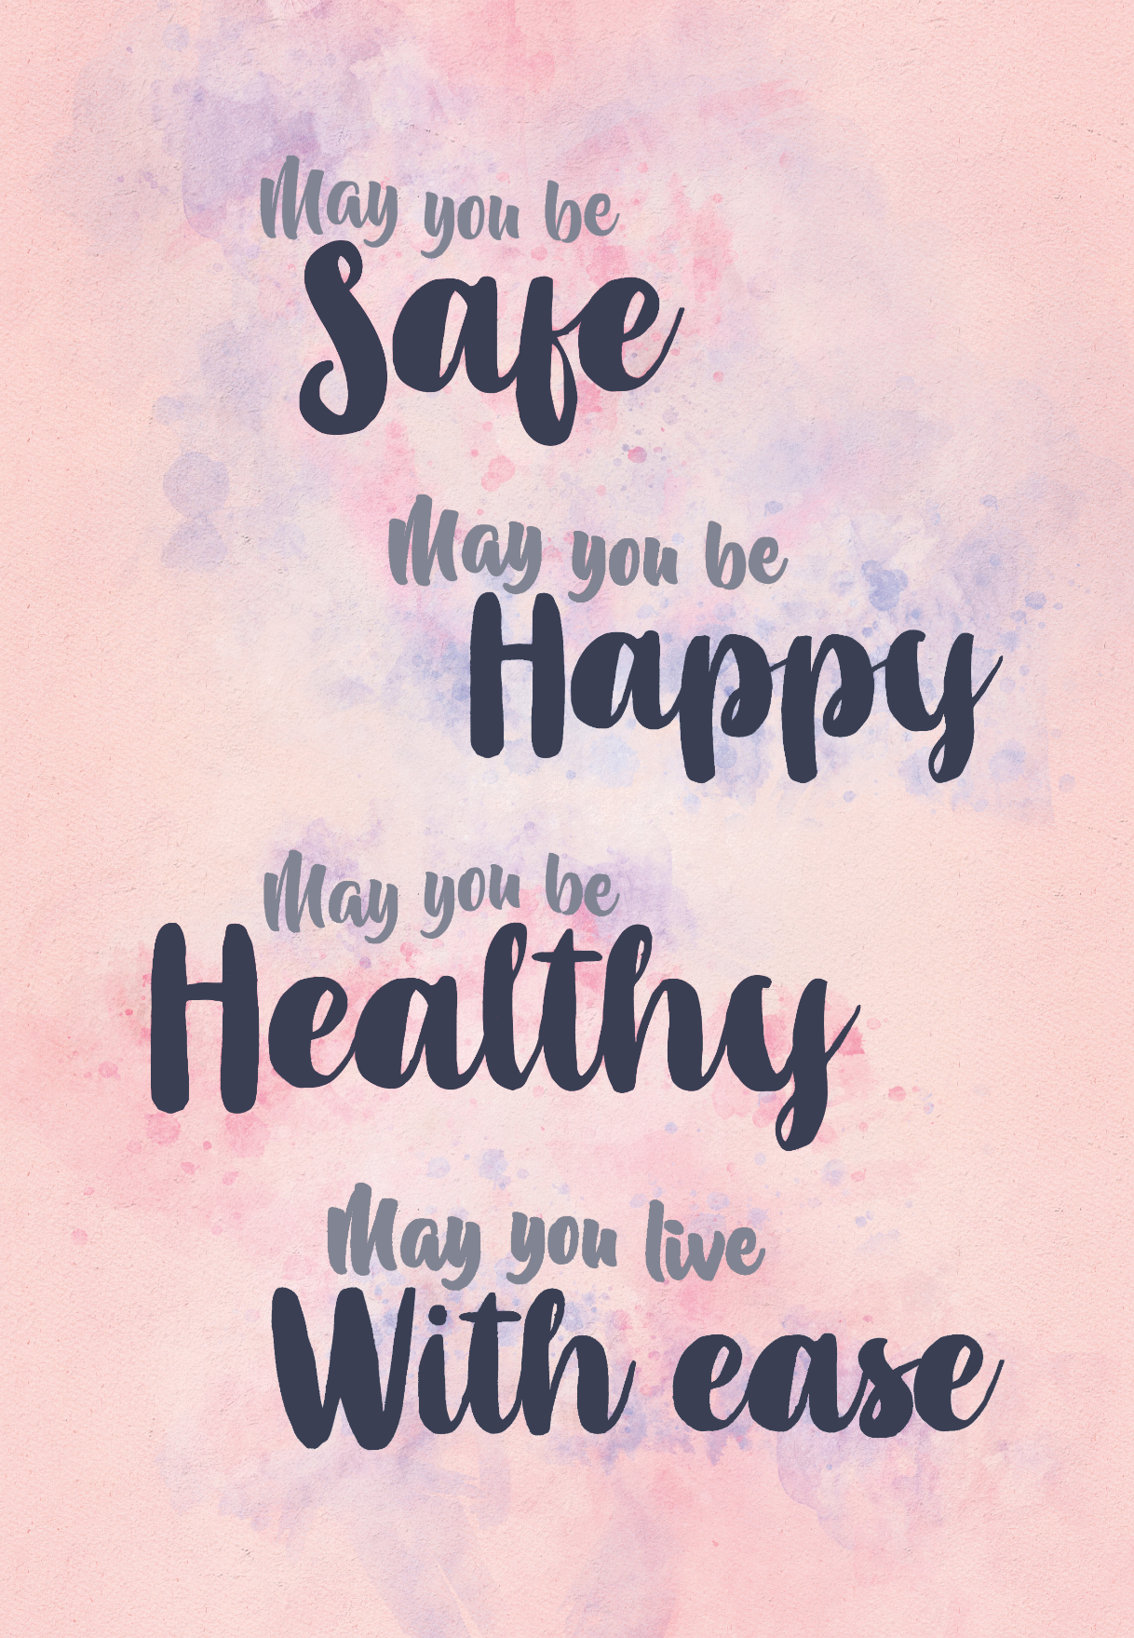
Loving-Kindness Meditation

