Slide 1
Things to
be Thankful
for Today

Slide 2
C
Cultivating
Compassion
Directing our compassionate mind:
Self-compassion
Chapter 17

Slide 3
Today’s Agenda
Things to be Thankful for Today
Ways to cultivate compassion for oneself
Self-compassion break
Loving-kindness meditation
Exploring our critical mind

Slide 4
Ways to cultivate compassion for oneself
Directing compassion to yourself:
-Imagery
-Compassion in the mirror
-Self-compassion break
-Loving-kindness meditation
-Exploring our critical mind
book
in class

Slide 5
Self-Compassion Break
This is a moment of suffering.
This hurts. This is stress.
Suffering is a part of life.
I am not alone, others feel this way.
May I be kind to myself in this moment.
It’s gonna be OK.
Mindfulness
Common Humanity
Self-Kindness
Notes:
Instructor notes:
Audio recording of Neff’s Self-compassion break (about 5min)
http://self-compassion.org/wp-content/uploads/2015/12/self-compassion.break_.mp3
Encourage students to choose their own phrases; only 1 phrase is needed per dimension of self-compassion
An additional useful resource on the self-compassion break
https://ggia.berkeley.edu/practice/self_compassion_break?_ga=2.226878553.59087812.1540186801-497012263.1531181521#
https://self-compassion.org/exercise-2-self-compassion-break/

Slide 6
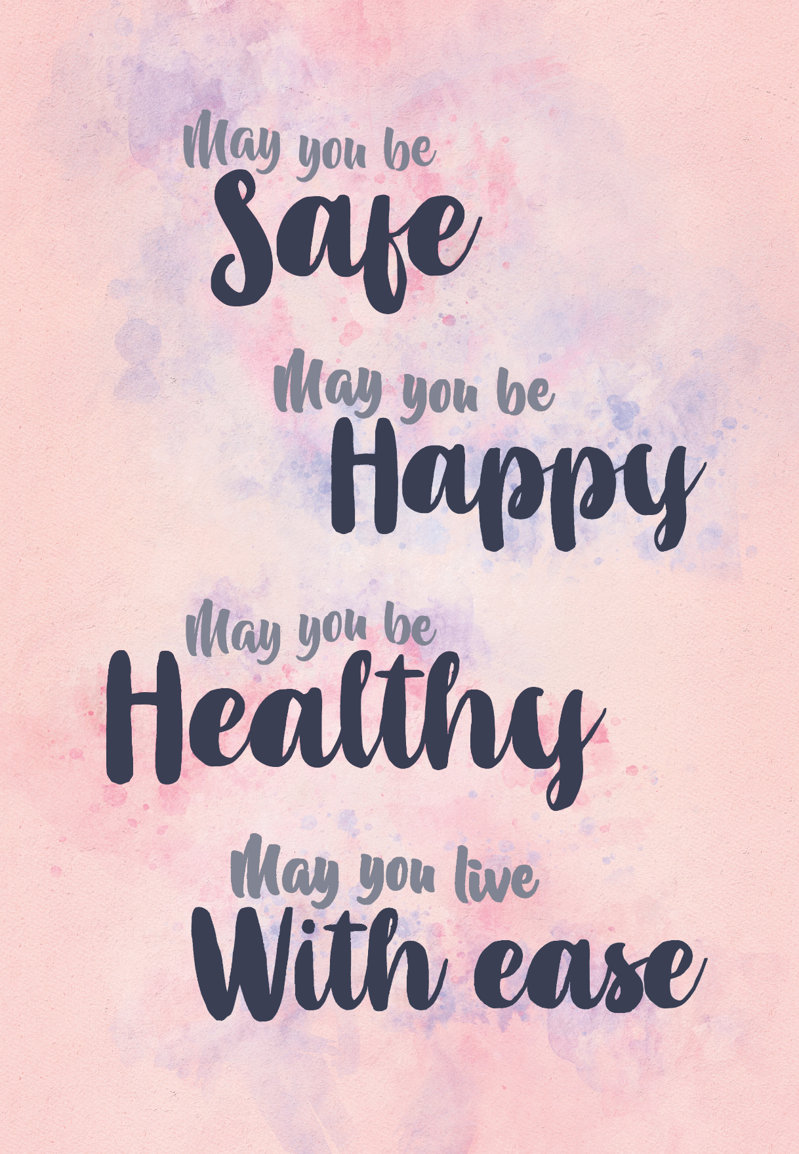
Loving-Kindness Meditation

Slide 7
Your Critical Mind
Notes:
Instructor Notes:
An introductory slide to the section of the lecture that discusses Exploring our Critical Mind

Slide 8
Investigate Obstructive Thoughts
Chose one limiting belief or thought
Is it true? (yes or no, if No then move to 3.)
Can you absolutely know that it’s true?
How do you react, what happens, when you believe that thought?
Who would you be without that thought?

Slide 9
Passengers on a bus-metaphor
Notes:
Instructor Notes:
Passengers on a bus- an Acceptance & Commitment (ACT) metaphor (4:51)
https://www.youtube.com/watch?v=Z29ptSuoWRc
Have students explore the metaphors in this video.

Slide 10
Naming Your Critical Mind
What is your critical mind’s name?
Explain why you chose this name.
Share characteristics of your critical mind.
What are the things that your critical mind is saying?
Why is your critical mind doing this?
What is the effect that your critical mind is trying to achieve?
Notes:
This activity is best assigned to be done at home and then discussed afterward.

Slide 11
Thanking your mind
Notes:
Instructor Notes:
Thanking your mind: Taking the power out of difficult thoughts (Dr. Russ Harris) (1:46)
https://youtu.be/206WtwEyqzg
*Connections can be made with this and the Two Wolves story regarding how to treat your critical brain and how to treat the angry wolf
Follow-up with discussing how the goal of your critical mind….to keep us safe

Slide 12
Defusion
Notes:
Instructor Notes:
Demystifying ACT - Defusion
https://www.youtube.com/watch?v=6CzyYj5IUVE (6:24)
Fusion is when two things stick together…
Defusion – pull the word away from the meaning if it is not helpful.
Look at the thought, not from your thought….just because you have the thought, doesn’t mean that you HAVE to do it

Slide 13
Defusion – I’m noticing I’m having the thought
Notes:
Instructor Notes:
Defusion – I’m noticing I’m having the thought
https://youtu.be/kwlYXupjoaI (1:25)

Slide 14
The Criticizer, the Criticized, and the Compassionate Observer
Let’s discuss the activity and your experience doing it
Notes:
Instructor Notes:
This activity is best assigned to be done at home and then discussed afterward.
Discuss the activity and their experiences

