Slide 1
Things to
be Thankful
for Today
Notes:
Instructor Notes:
-Each class session students will use markers to write at least one thing they are thankful for on an index card and use a magnet to post it on the magnetic white board. (Alternatively, Post It Notes could be used, or students could write directly on the Whiteboard/Chalkboard).
-This activity integrates Gratitude into our class sessions and helps students to focus on positive things in their life.
-”We will be learning in this course about how our brains have evolved to notice negative or potentially harmful aspects of our environment. While this is functional to a certain extent, it can lead to negative consequences for our psychological and physical health. When we strengthen our ability to identify positive things in our lives, things we are thankful for, things that make us happy, even small things that went ‘right’, we can train our brain to focus more on the positive. This can result in many beneficial outcomes.
Each day at the beginning of class, I’d like you to write down something you are thankful for that day, put your name and date on the back, and put it up on the whiteboard. ”

Slide 2
C
Cultivating
Compassion
Directing our compassionate mind:
Experiencing compassion from others
Chapter 16
Notes:
.

Slide 3
Today’s Agenda
Things to be Thankful for Today
Updates on hearts & post-its
Loving-kindness meditation
Cultivating our openness to receive compassion
Memory of receiving compassion from others
Openness to receiving compassion from others

Slide 4
Updates on: Positive Post-it Notes Compassion Hearts
You are awesome!

Slide 5
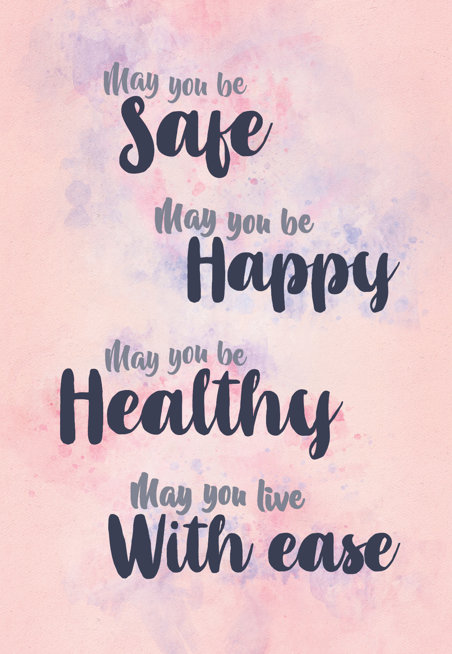
Loving-Kindness Meditation

Slide 6
Being open to receiving care and compassion from others
Experiencing compassion flowing towards you:
Using your ideal compassionate other
Being open to care, compassion, kindness of people in daily life:
Recalling a recent act of care, compassion, kindness from another

Slide 7
Compassion from others memory
Share a memory of a recent time when you were struggling and received compassion from another.
How did this person know you were struggling?
What did they do to help?

Slide 8
Openness to receiving compassion from others What might help you be more likely to notice and be open to accepting care, compassion, kindness? Who are we likely to accept help from (or not)? Under what circumstances are we more or less likely to accept help?

