Slide 1
Things to
be Thankful
for Today

Slide 2
C
Cultivating
Compassion
Directing our compassionate mind:
Compassion for others
Chapter 15
Notes:
CMW Section V Introduction and Ch. 15

Slide 3
Today’s Agenda
Things to be Thankful for Today
3 ways to cultivate compassion for others
Loving-kindness meditation
Compassion hearts
Memory of compassion for other
Positive post-it notes

Slide 4
Flows of Compassion
Showing compassion for others
Receiving compassion from others
Showing compassion for oneself
Self-compassion
Observing compassion between others
Notes:
Instructor notes:
Section V introduction
Remind students of the flows of compassion
CMW only discusses the first 3 flows of compassion
Showing/Giving compassion for others
Being open and receptive to Receiving compassion from others
Showing/Giving compassion for ourselves/being open and receptive to receiving compassion from ourselves (self-compassion)
Observing and recognizing compassion flowing between others
Today we’ll focus on the first flow, showing compassion for others

Slide 5
Cultivate our compassion for others
Directing positive emotions/intent to others:
Loving-kindness meditation
Acts of kindness & compassion:
Compassion Hearts; Post-it Notes
Compassionate memory:
Recalling a memory of a time you showed compassion for another

Slide 6
An Introduction to Loving-Kindness Meditation
Notes:
Instructor Notes:
An Introduction to LovingKindness Meditation from Sharon Salzberg and 10% (6:46)
https://youtu.be/gJNLbPpVT_Q

Slide 7
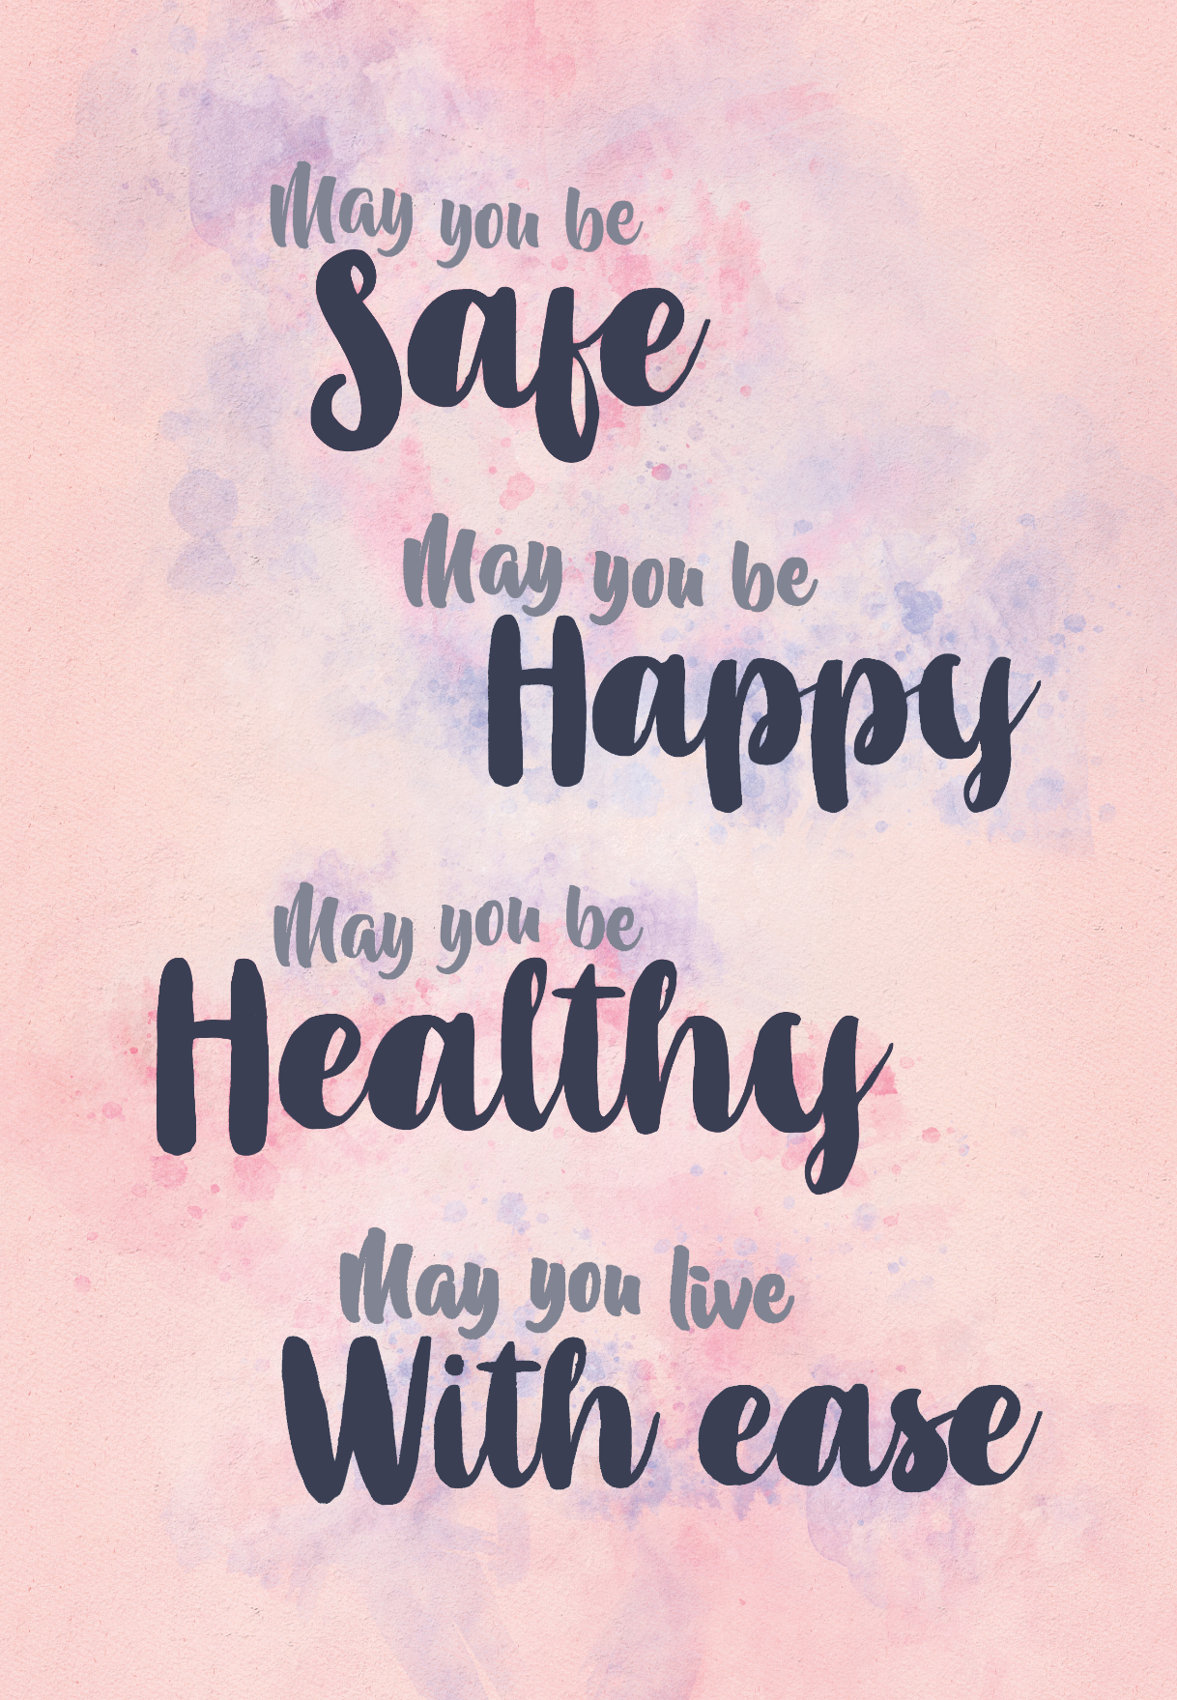
Loving-Kindness Meditation

Slide 8
Street Loving-Kindness: Stuck in a traffic
Notes:
Instructor Notes:
Stuck in Traffic STREET LOVINGKINDNESS with Sharon Salzberg (1:49)
https://youtu.be/kWnKxKHf9Zo

Slide 9
Compassion Hearts

Slide 10
Notes:
Instructor Notes:
Here are related quotes that you may chose to share with the class.
“If you can’t feed a hundred people, then feed just one.” Mother Teresa
“People think traveling to the past and doing something small will drastically change the present, but no one in the present thinks they can drastically change the future by doing something small now.” Unknown
“If you think you’re too small to make a difference…try sleeping with a mosquito in the room” Dalai Lama

Slide 11
Compassionate Memory
Share a memory of a time when you showed compassion to someone.
Notes:
Instructor Notes:
Full-Class Discussion
As we are working on creating our compassion hearts, let’s each share a memory of a time when we were compassionate to someone.

Slide 12
Positive Post-It Notes
You are awesome!
Notes of positivity and encouragement
Leave notes for others
Leave notes for yourself

Slide 13
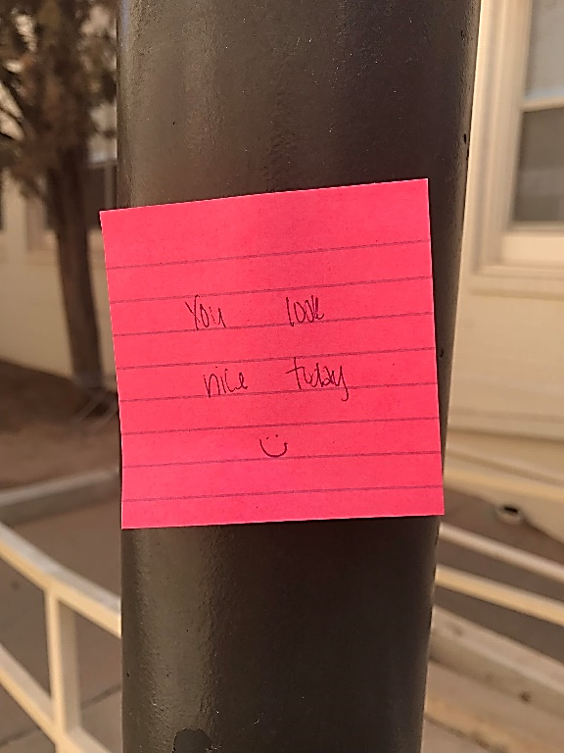
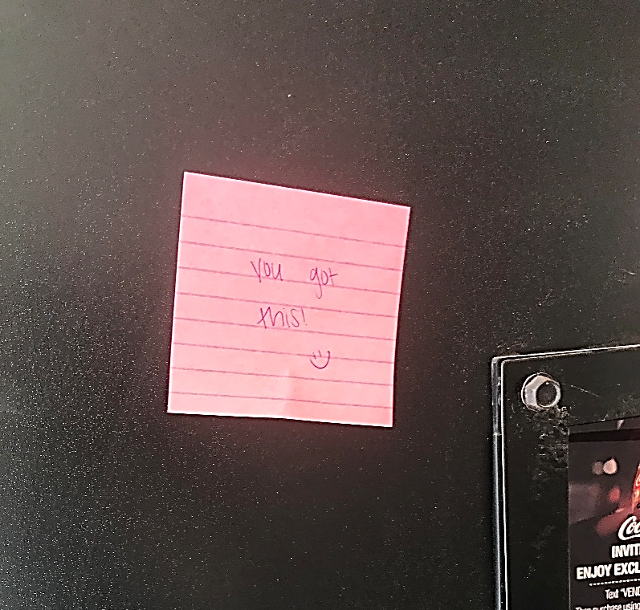
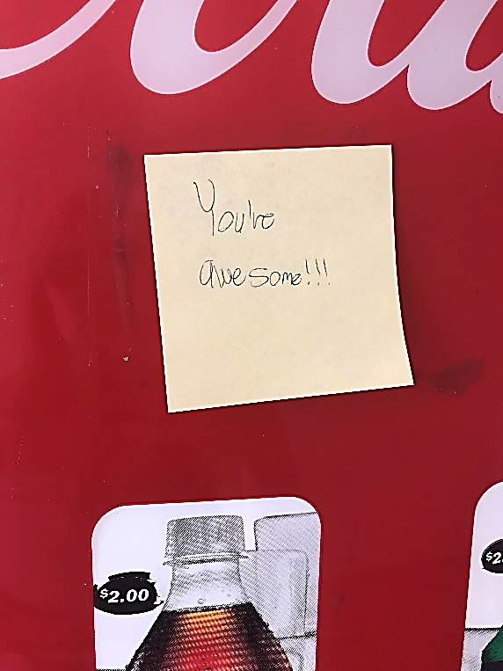
Notes:
Instructor Notes:
Notes found around ASU campus September 18, 2018

Slide 14
Gideon Borman: Post-it Man
Notes:
Instructor Notes:
Gideon Borman Post-it Man, Amsterdam, The Netherlands (2:23)
http://www.youtube.com/watch?v=dXSTgnk7yrg

Slide 15
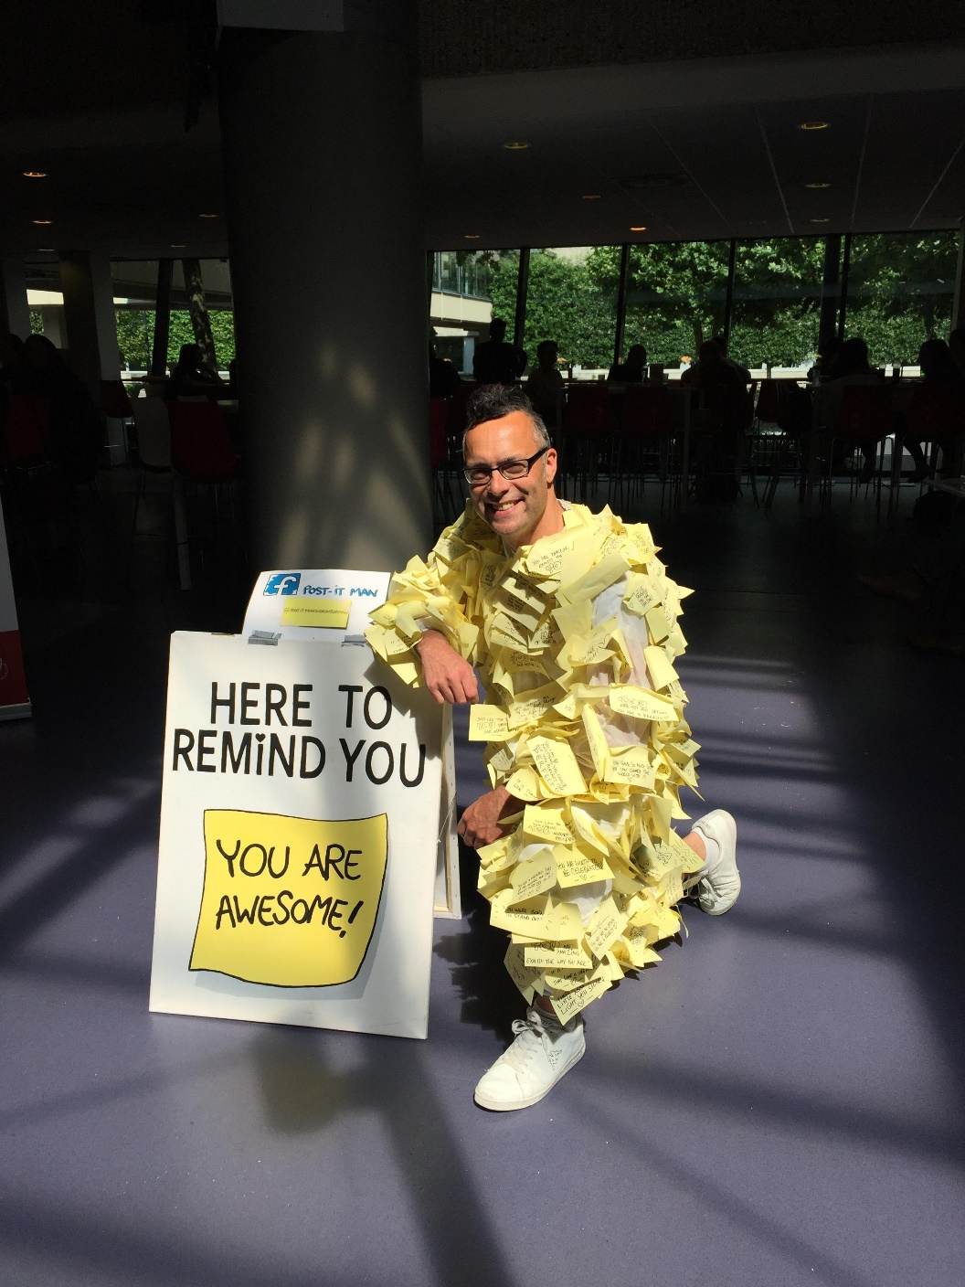
Notes:
Instructor Notes:
Gideon Borman=Post-it Man

