Slide 1
Things to
be Thankful
for Today

Slide 2
C
Cultivating
Compassion
Developing our compassionate mind:
Developing our compassionate self
Chapter 12
Notes:
Section IV introduction and CMW Ch. 12

Slide 3
Today’s Agenda
Things to be Thankful for Today
Just like me meditation
Compassion as self-identity
Two wolves story
The lotus in the mud
Compassionate memory
3 Core qualities of compassionate self

Slide 4
Just like me meditation
Notes:
Instructor Notes:
Just Like Me and Loving Kindness Compassion Mediation for Kids
https://youtu.be/xlNLIstIl1Y (6:46)

Slide 5
Compassion as a self-identity
We all have multiple identities
Identities shape how we think, feel & act
Cultivating our compassionate self
Acting techniques
Using memory
Notes:
Instructor Notes:

Slide 6
Two wolves story
Notes:
Instructor Notes:
How mindfulness empowers us: An animation narrated by Sharon Salzberg
https://youtu.be/vzKryaN44ss (2:21)
This video tells the Two Wolves story that is also discussed in CMW on page 165

Slide 7
What are your reactions to this story?

Slide 8
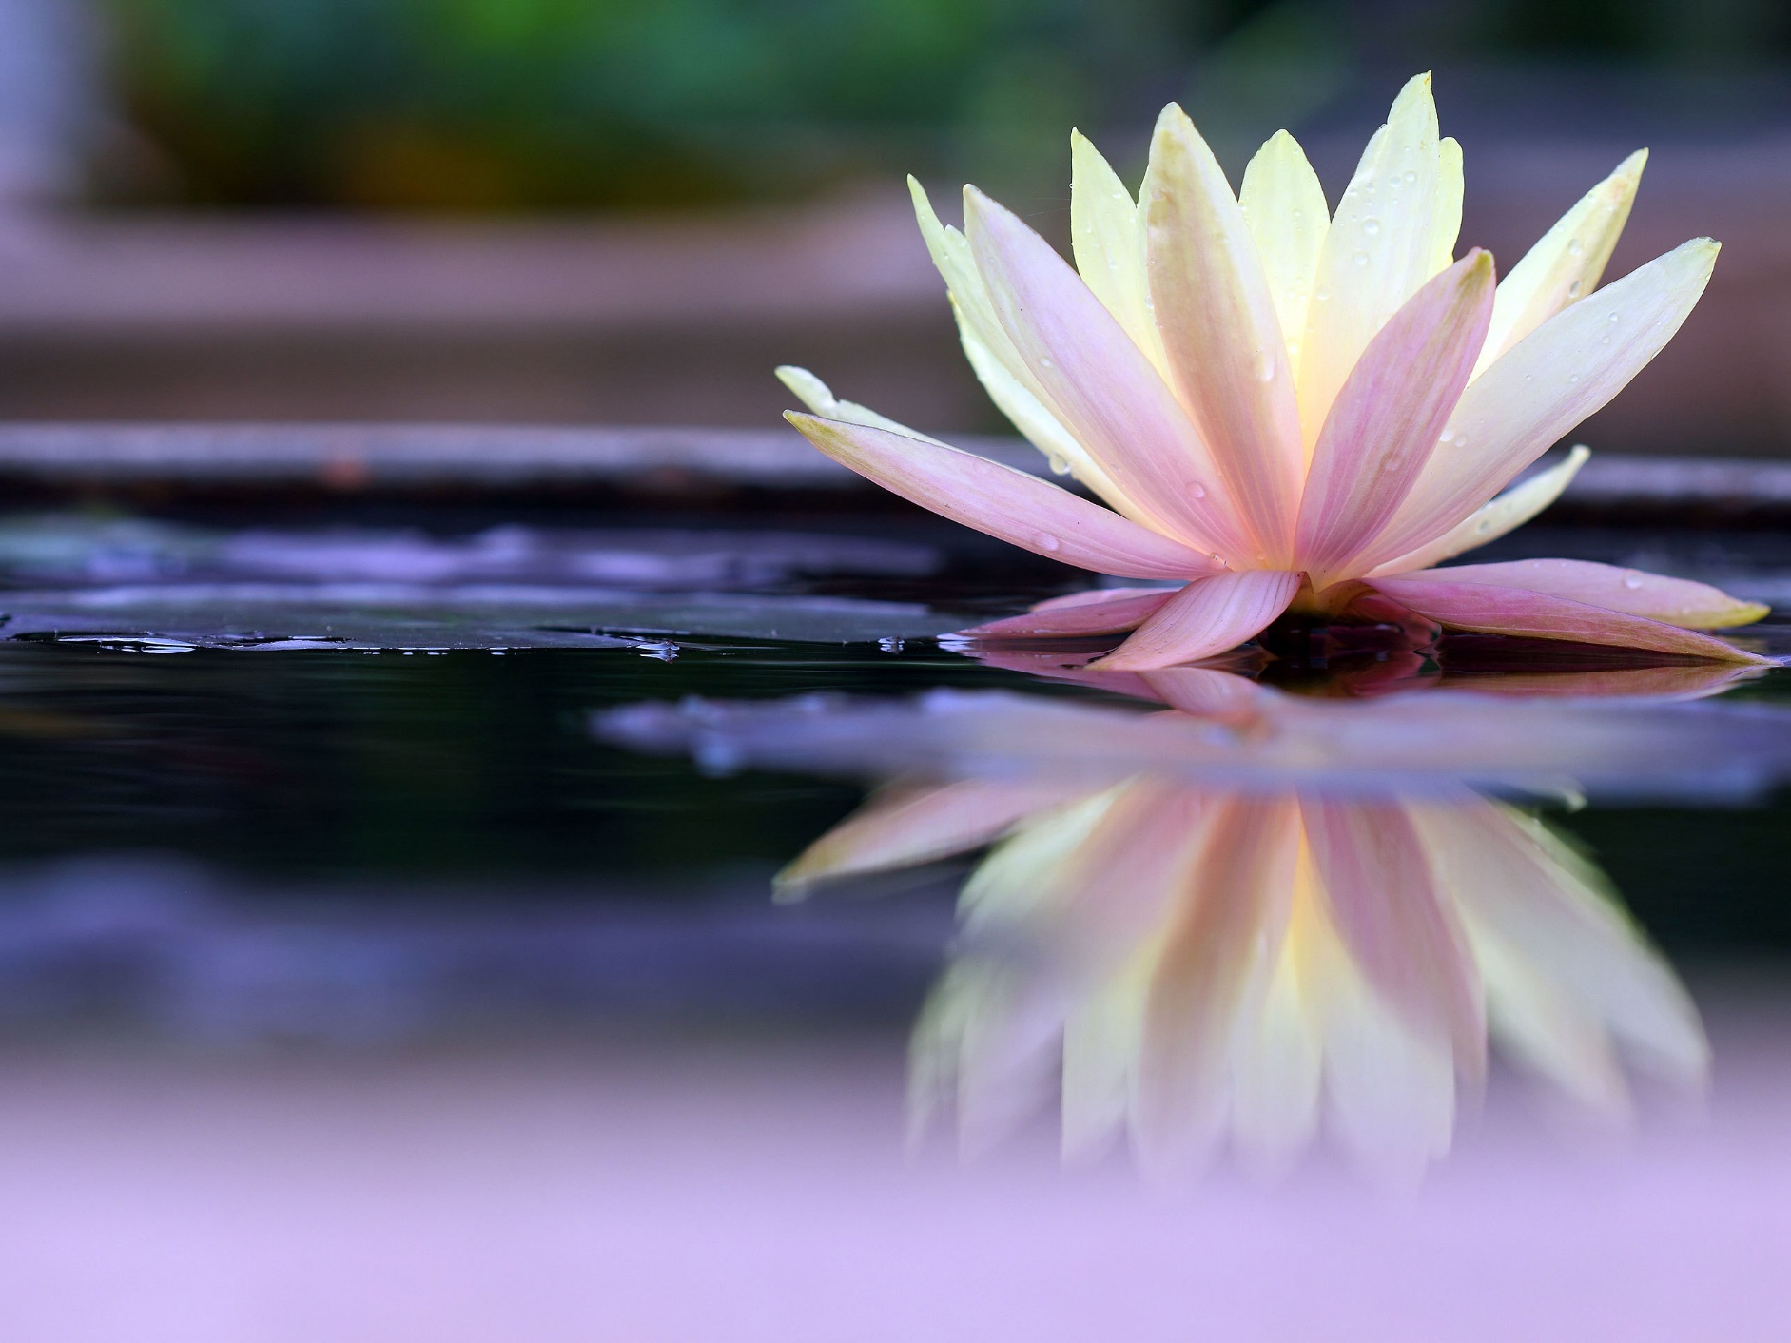
The Mud and the Lotus

Slide 9
How does the story resonate with you?

Slide 10
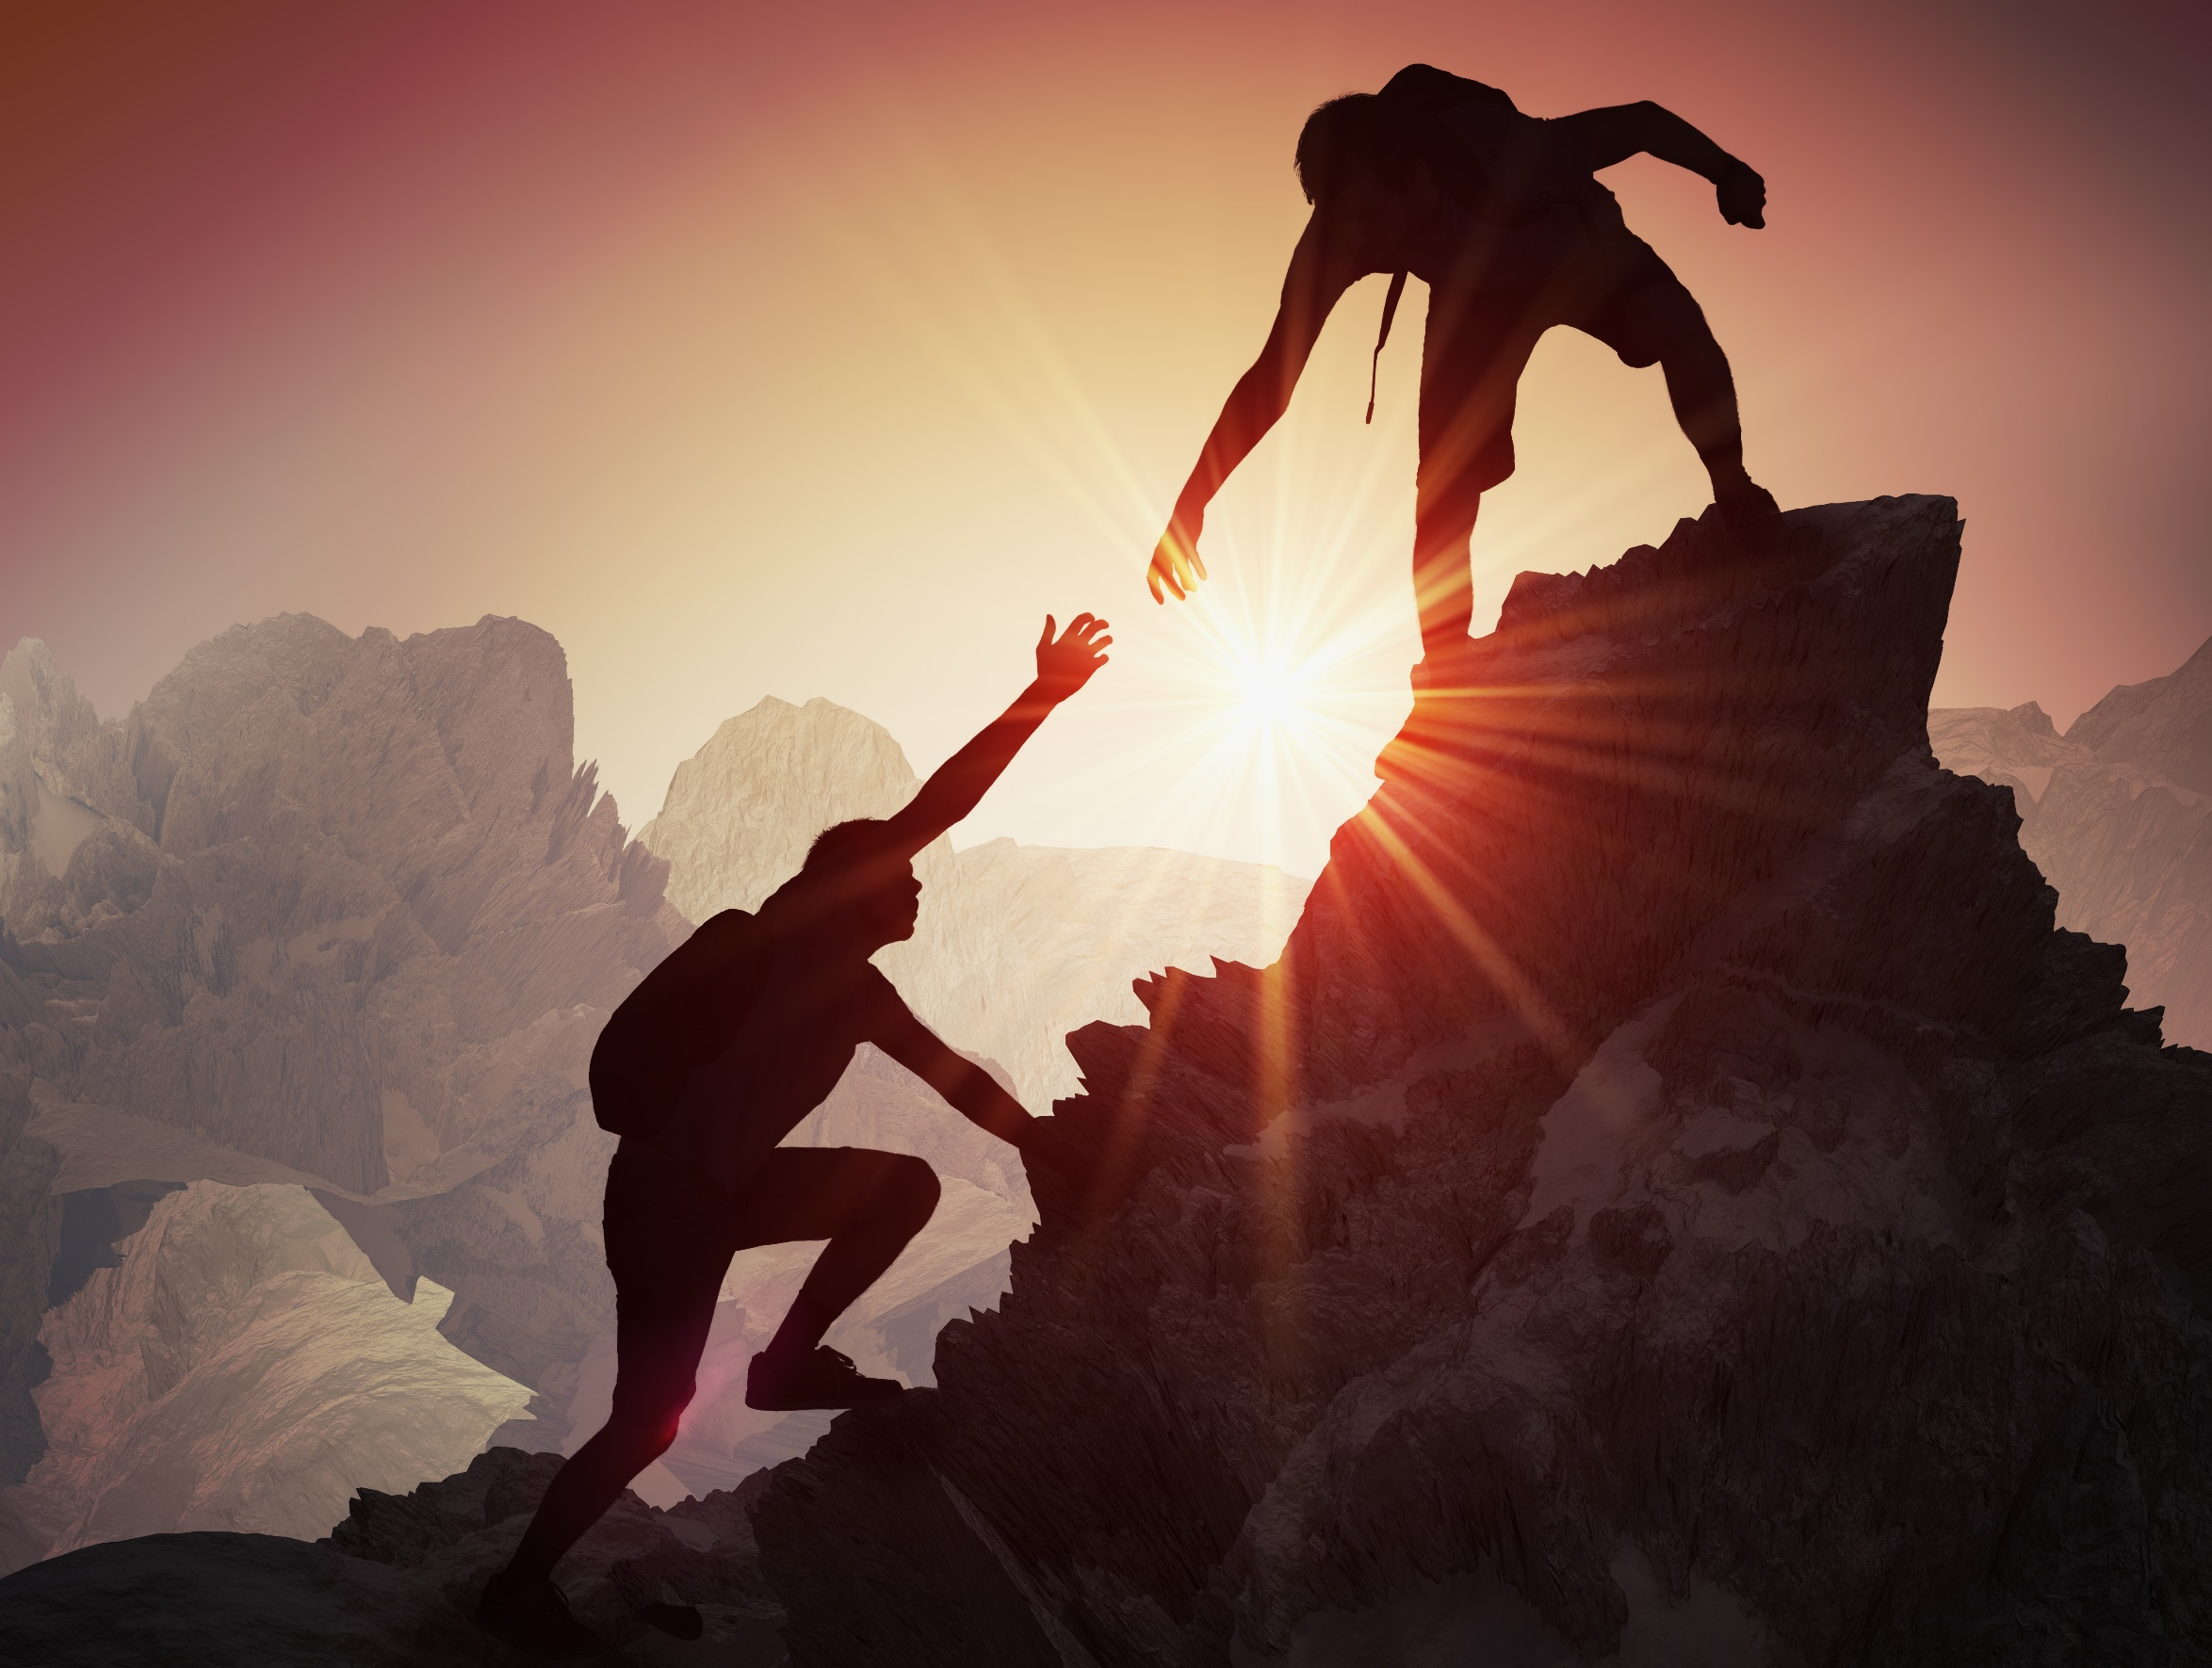
Compassionate Memory
Notes:
Instructor Notes:
CMW p. 170
Exercise 1: Compassionate Memory

Slide 11
3 Core qualities of our compassionate self
Wisdom
Caring-Commitment
Strength & Courage

Slide 12
Boy helps elderly woman
Notes:
Instructor Notes:
Boy helps elderly woman struggling to walk up stairs
https://youtu.be/6A9gekfnN70 (1:05)

