Slide 1
Things to
be Thankful
for Today
Notes:
Instructor Notes:
***Today, we are adding a bit to our practice….
"Talking about something you are grateful for is very different than actually feeling grateful for something. Just like with achieving goals or dreams, a shift happens when you go from talking to doing. The same is true with gratitude -- when you go from thinking to actually feeling, you begin to open yourself up to the benefits that come from regularly experiencing this emotion." Then have them write their TTBTF card AND describe the emotions they experienced while selecting and writing their cards.

Slide 2
C
Cultivating
Compassion
Building Capacity and Foundations for Compassion:
Building the Drive System
Chapter 11

Slide 3
Today’s Agenda
Things to be Thankful for Today
Breathing awareness w/ color
Building our drive system
What’s good about….?
Gratitude meditation

Slide 4
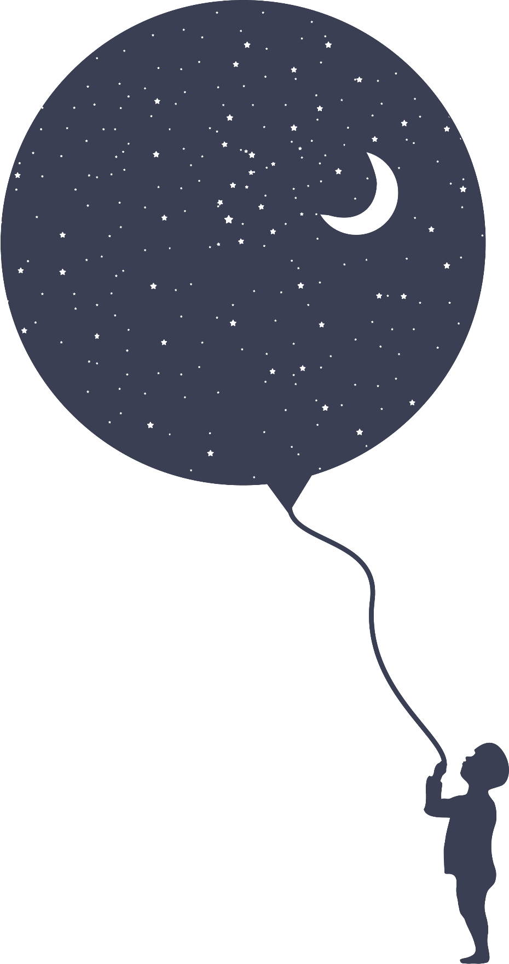
I’m % present today, the rest of me is .

Slide 5
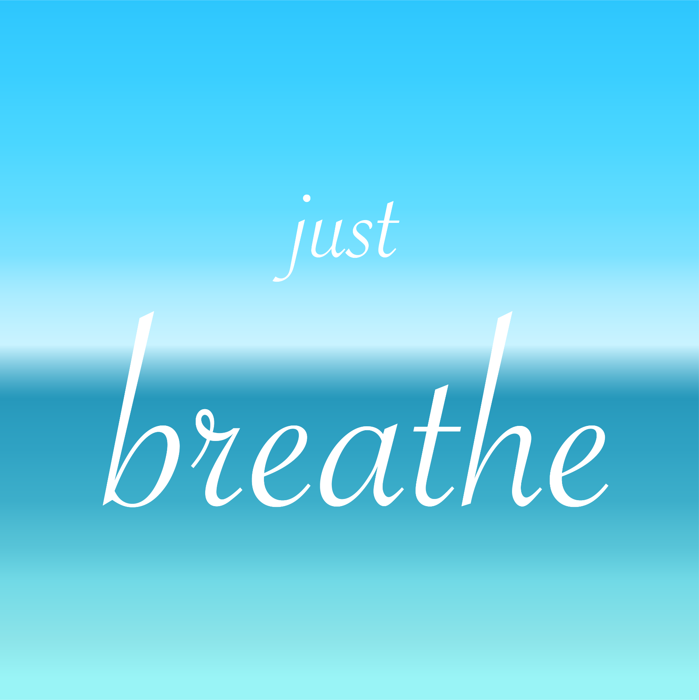
Notes:
Instructor Notes:
Breath Awareness Practice adding in color imagery
****To tie in color imagery from the last chapter, suggest that students try breathing in one color of their choice and out another color of their choice*****

Slide 6
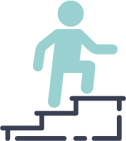
Three Systems & Compassion
Caring motivation = Soothing system
Energy of the Drive system helps us engage distress from Threat system
Drive system, with it’s energizing, motivating impact, urges us to seek meaningful experiences

Slide 7
Drive System
Drive and Achievement-focused
Motivates us to move towards helpful resources and goals
Excitement & Joy
Activating our Sympathetic Nervous System

Slide 8
Drive System
We can build a healthy, sustainable, balanced drive system through mindfulness practices focused on:
Focus on Purpose and Meaning in Life
Gratitude and Appreciation

Slide 9
Values vs. Goals
Notes:
Instructor Notes:
Values vs. Goals - By Dr. Russ Harris (3:41)
https://youtu.be/T-lRbuy4XtA

Slide 10
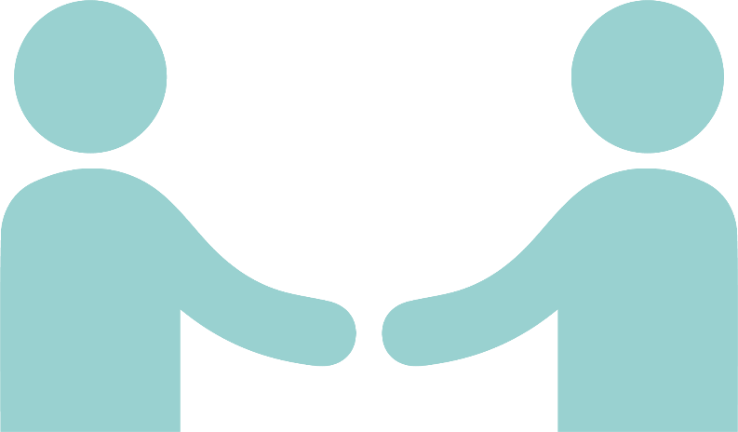
What’s good about….?
Open your slip of paper, read it out loud to your partner
Name as many positive things as possible about this scenario in 60 seconds
Then it’s your partner’s turn
Notes:
Instructor Notes:
-When someone is unfriendly to you.
-When you are broke.
-Lying in bed for a week with the flu.
-When a romantic relationships ends.
-When you are stuck in traffic because there was an accident up ahead.
-When you don’t earn the grade you were expecting/hoping for on an exam
This exercise gives us perspective….there is always a positive.

Slide 11
Gratitude
“a social emotion that signals our recognition of the things others have done for us” (Fox et al., 2015).
Different from indebtedness
Both emotions occur following help, but….
Indebtedness – obligation to repay or compensate
Can motivate avoidance
Gratitude can motivate you to seek more contact
Notes:
Instructor Notes:
The definition is from https://positivepsychologyprogram.com/gratitude-appreciation/
The information on indebtedness is from a book entitled: 201 Positive Psychology Applications

Slide 13
Gratitude Meditation
Notes:
Instructor Notes:
5 minute guided meditation for gratitude (5:56)
https://youtu.be/OCorElLKFQE

Slide 14
Benefits of Gratitude and focusing on Positive Experiences
Increases in
Joy, Happiness, Optimism for future
Improved
Physical and Mental Health (lower depression)
Doesn’t mean we ignore the pain, but noticing the good can bring perspective and balance

Slide 15
Flow
Notes:
Instructor Notes:
Flow by Mihaly Csikszentmihalyi – Animated book review (5:20)
https://youtu.be/8h6IMYRoCZw

