Slide 1
Things to
be Thankful
for Today

Slide 2
C
Cultivating
Compassion
Building Capacity and Foundations for Compassion:
Attention and Mindfulness
Chapter 8

Slide 3
Today’s Agenda
Things to be Thankful for Today
Breath awareness practice
Mindfulness
Attention
Mindfulness practices
Anchored
Unanchored

Slide 4
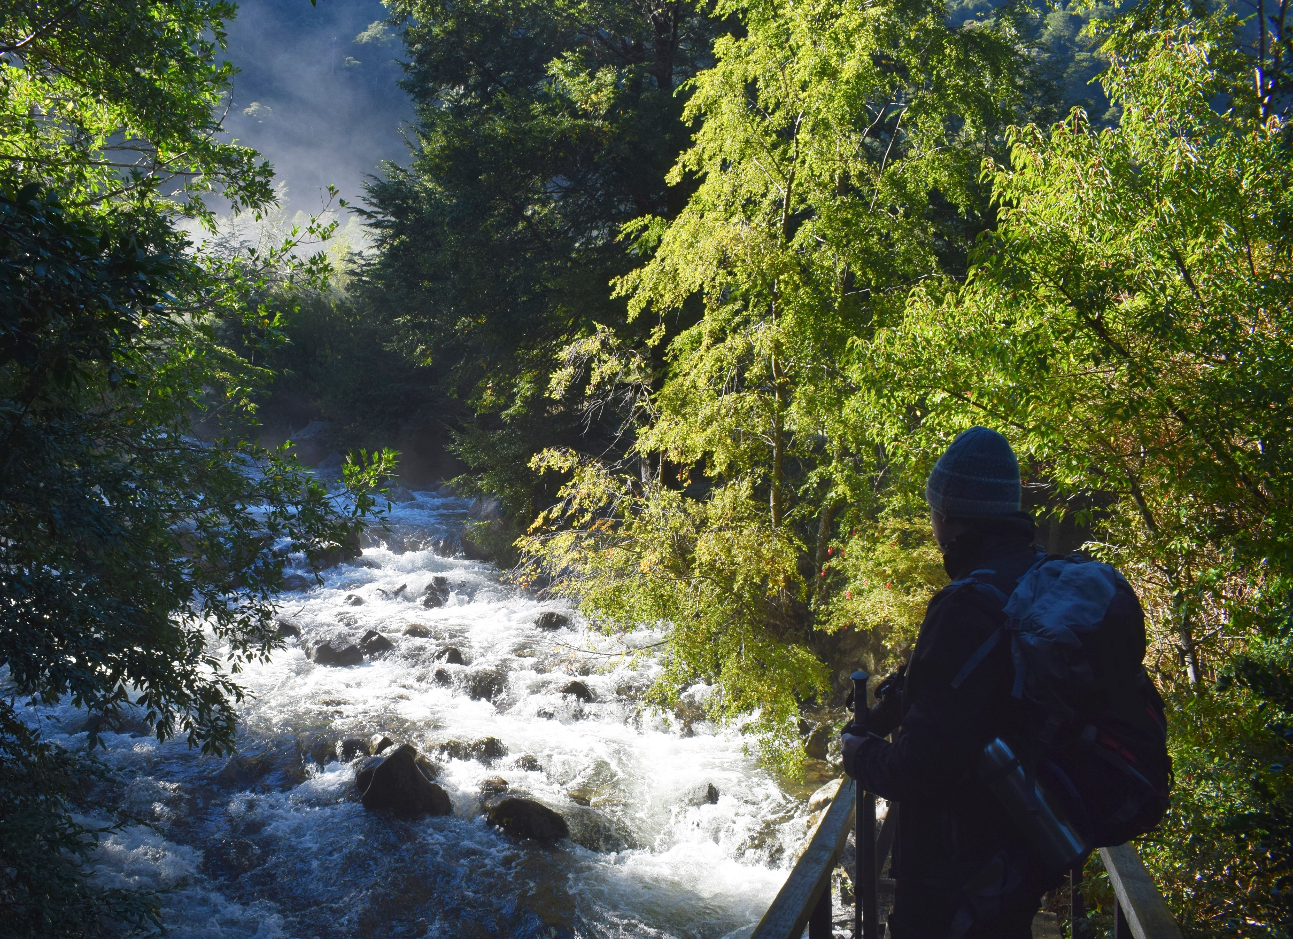
Allow your thoughts to flow
Notes:
Instructor Notes:
Discuss the idea of allowing thoughts to flow as we watch them from the bank of the river without trying to hold onto the thoughts

Slide 5
Notes:
Breath Awareness Meditation

Slide 6
Why mindfulness is a superpower
Notes:
Instructor Notes:
Why mindfulness is a superpower: An animation (2:43)
Happify
https://youtu.be/w6T02g5hnT4

Slide 7
Mindfulness
Ability to pay attention, in the present moment, without judging
Formal and informal practices
Mindfulness Meditations
Formal practices to help achieve mindfulness

Slide 8
Planting the seeds of mindfulness
Notes:
Instructor Notes:
Mind in a Jar - Planting Seeds of Mindfulness MOVIE! (1:13)
https://www.youtube.com/watch?v=QNmMH6tqiMc&feature=youtu.be

Slide 9
Attention
A mental ability that involves noticing
Nature of attention
Can be consciously directed; it is moveable
Spotlight analogy
It is often effortful & difficult to direct your attention
It is hard to hold attention in one place
Jumps around, getting caught in loops

Slide 10
I’m % present today, the rest of me is .

Slide 11
The power of mindfulness: What you practice grows stronger
Notes:
Instructor Notes:
The power of mindfulness: What you practice grows stronger: Shauna Shapiro (13:45)
https://youtu.be/IeblJdB2-Vo

Slide 12
Mindfulness – Anchored Practices
Mindful breathing/Breath awareness
breath
internal
Body scan
bodily sensation
internal
Mindfulness of sound
sound
external

Slide 13
Mindfulness – Unanchored Practices
Beyond the anchor – noticing the shifting landscape of our minds…
Mindful labeling
Labeling thoughts
Labeling feelings

Slide 14
Mindful Labeling

Slide 15
Mindfulness
Mindful Walking
Mindful Eating
Notes:
Instructor Notes:
These practices can be done formally or informally

Slide 16
Mindful Eating

Slide 17
What is one daily activity that you could chose to do mindfully this week?
Notes:
Instructor Notes:
Full-Class Discussion
Examples: brushing your teeth, showering, mindfully eating the first and last bites of meals, driving
This would be an example of an informal mindfulness practice

