Slide 1
Things to
be Thankful
for Today

Slide 2
C
Cultivating
Compassion
Understanding compassion:
Why compassion can be difficult
Chapter 7

Slide 3
Today’s Agenda
Things to be Thankful for Today
Compassion can be hard sometimes…
Common difficulties with compassion
Fears of compassion questionnaire
Body scan meditation

Slide 4
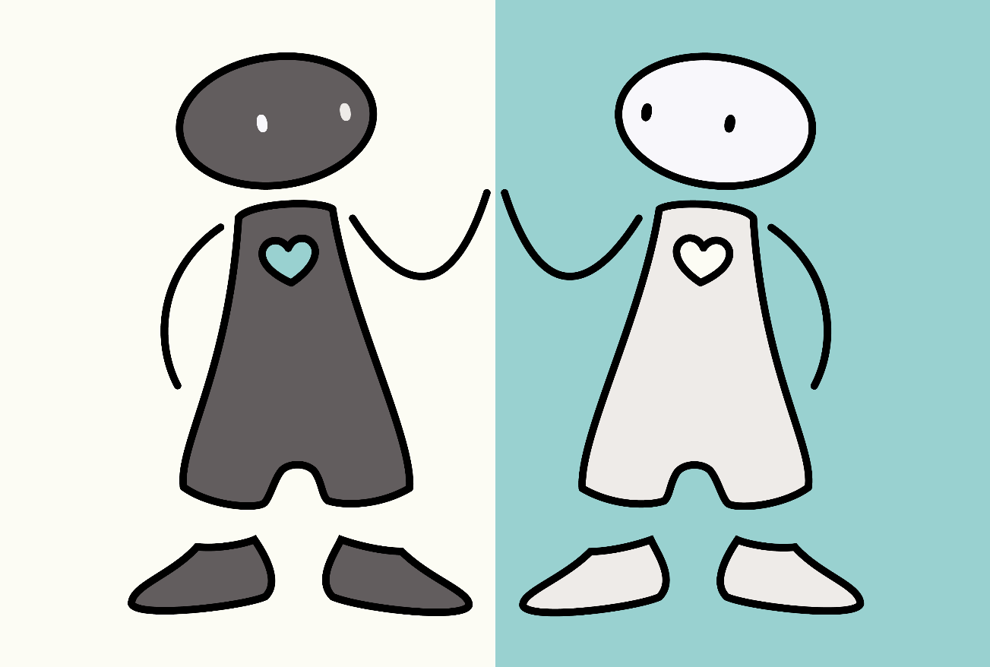
Compassion can be hard sometimes…
Fears
Blocks
Resistances

Slide 5
Compassion is natural: So why is it so hard for us?
Notes:
Instructor Notes:
Compassion is natural: So why is it so hard for us? (Big Think)
https://youtu.be/m2h1Ioug-ss (3:30)

Slide 6
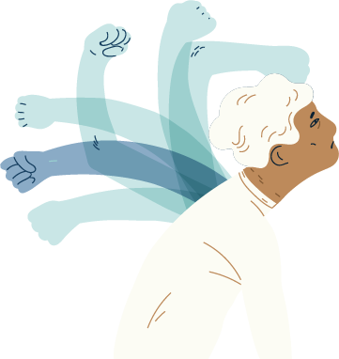
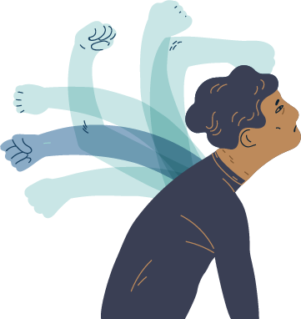
Common difficulties with compassion
Self-monitoring & self-criticism
Compassion as weak
Compassion as letting ourselves off the hook
Compassion as ‘alien’
Painful memories

Slide 7
Fears of Compassion Questionnaire
Notes:
Instructor notes:
Have students take the Fears of Compassion Questionnaire, which can be found online at
www.compassionatemind.co.uk
Here is the direct link: https://compassionatemind.co.uk/uploads/files/fears-of-compassion-scale.pdf
The three subscales fit nicely with the three flows of compassion discussed in Chapter 6.
-Expressing compassion for others
-Responding to compassion from others
-Expressing kindness and compassion towards yourself

Slide 8
Overcoming Objections to Self-Compassion
Notes:
Instructor Notes:
Overcoming objections to self compassion
https://youtu.be/YFhcNPjIMjc (12:23)

Slide 9
Body Scan
Notes:
Instructor notes:
Body Scan Meditation

Slide 10
Reimagining Compassion as Power
Notes:
Instructor Notes:
Reimagining compassion as power: Tim Dawes
https://youtu.be/E_guy-i2BTE (17:59)

