Slide 1
Things to
be Thankful
for Today

Slide 2
C
Cultivating
Compassion
Understanding compassion:
The flows of compassion
Chapter 6
Notes:
Instructor Notes:
Chapter 6 in CMW plus an additional definition of compassion from Kelly McGonigal and additional information from Kristin Neff on the three components of self-compassion

Slide 3
Today’s Agenda
Things to be Thankful for Today
Mindful listening
Components of compassion
Flows of compassion
Self-compassion

Slide 4
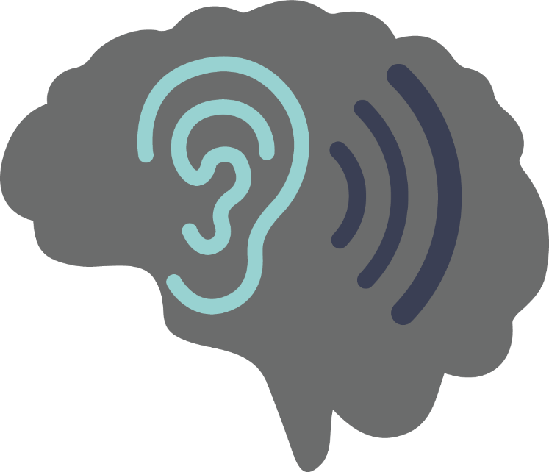
Mindful Listening
Notes:
Instructor notes:
Mindful listening….focusing on the sound of the mini cymbals until the sound is gone

Slide 5
Components of Compassion Kelly McGonigal
Awareness and recognition of suffering
Feelings of concern for, connection to the one who is suffering
Desire to relieve suffering
Belief that you can make a difference, even if small
Willingness to respond or take action
Warm glow/sense of satisfaction
Notes:
Instructor notes:
Not in CMW
Kelly McGonigal’s definition/explanation of compassion, a more detailed definition of compassion.
Awareness and recognition of suffering (Cognitive)
Feelings of concern for, connection to the one who is suffering (Affective)
Desire to relieve suffering (Motivational)
Belief that you can make a difference, even ifsmall (Cognitive)
Willingness to respond or take action (Behavioral)
Warm glow/sense of satisfaction (this is critical for compassion to be sustainable) (Affective)
Ask students to identify the cognitive, affective, motivational and behavioral aspects

Slide 6
Flows of Compassion
Showing compassion for others
Receiving compassion from others
Showing compassion for oneself
Self-Compassion
Observing compassion between others
Notes:
Instructor notes:
CMW only discusses the first 3 flows of compassion
Showing/Giving compassion for others
Being open and receptive to Receiving compassion from others
Showing/Giving compassion for ourselves/being open and receptive to receiving compassion from ourselves (self-compassion)
Observing and recognizing compassion flowing between others

Slide 7
Flows of Compassion
Showing compassion for others
Notes:
Instructor notes:
CMW only discusses the first 3 flows of compassion
Showing/Giving compassion for others
Being open and receptive to Receiving compassion from others
Showing/Giving compassion for ourselves/being open and receptive to receiving compassion from ourselves (self-compassion)
Observing and recognizing compassion flowing between others
Compassionate Flowing Out
To try this exercise, sit somewhere quiet where you won’t be disturbed and begin to focus on your breathing. Think about a time when you felt very kind and caring towards a person or a beloved animal.
Try not to choose a time when that person or animal was very distressed because then you are likely to focus on that distress instead of the kind, compassionate feelings for him or her. Next, focus on the desire to help the person or animal, and the feelings of kindness that will guide you to help. Remember that in this exercise it is your intentions that are important, not how the person or animal responds.
Bring to mind a specific time when you felt compassionate towards him or her. Imagine yourself expanding, as if you are becoming calmer, wise, stronger, and more responsible, and able to help him or her.
Pay attention to your body as you remember how it felt to be kind. Spend some time expanding with warmth in your body. Notice the genuine desire for this person to be free of suffering and to flourish.
Spend a minute or two thinking about the tone of your voice and the kinds of things you said, or the kinds of things you did or wanted to do to help.
Spend another minute or two on thinking about how good it felt to be kind to him or her.
Finally, focus only on your desire to be helpful and kind: the sense of warmth, feelings of expansion, your kind tone of voice, the wisdom in your voice and your behavior. When you have finished this exercise, you may want to take some notes about how this felt for you.
https://positivepsychologyprogram.com/compassion-focused-therapy-training-exercises-worksheets/

Slide 8
Flows of Compassion
Receiving compassion from others
Notes:
Instructor notes:
CMW only discusses the first 3 flows of compassion
Showing/Giving compassion for others
Being open and receptive to Receiving compassion from others
Showing/Giving compassion for ourselves/being open and receptive to receiving compassion from ourselves (self-compassion)
Observing and recognizing compassion flowing between others

Slide 9
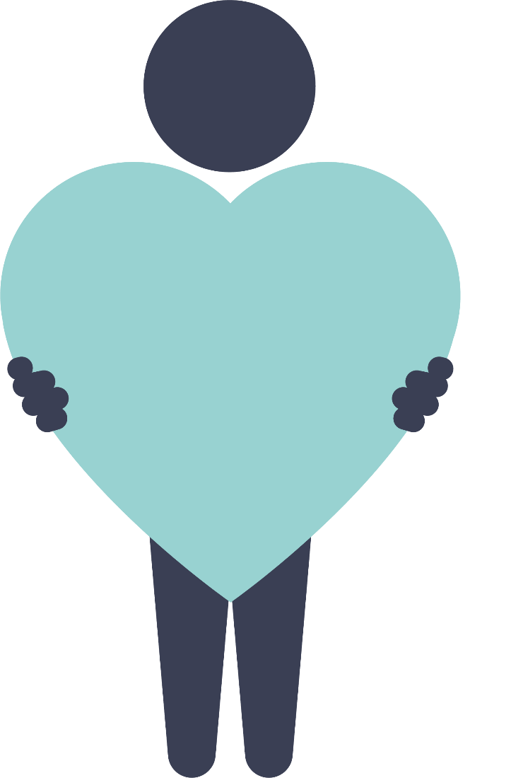
Flows of Compassion
Showing compassion for oneself
Self-Compassion
Notes:
Instructor notes:
CMW only discusses the first 3 flows of compassion
Showing/Giving compassion for others
Being open and receptive to Receiving compassion from others
Showing/Giving compassion for ourselves/being open and receptive to receiving compassion from ourselves (self-compassion)
Observing and recognizing compassion flowing between others

Slide 10
Flows of Compassion
Observing compassion between others
Notes:
Instructor notes:
CMW only discusses the first 3 flows of compassion
Showing/Giving compassion for others
Being open and receptive to Receiving compassion from others
Showing/Giving compassion for ourselves/being open and receptive to receiving compassion from ourselves (self-compassion)
Observing and recognizing compassion flowing between others

Slide 11
How would YOU treat a FRIEND?

Slide 12
If your COMPASSION does not include YOURSELF it is incomplete. Jack Kornfield

Slide 13
3 Components of Self-Compassion
Self-kindness vs. Self-judgment
Common humanity vs. Isolation
Mindfulness vs. Over-identification
Notes:
Instructor notes:
Not in CMW
Kristin Neff’s 3 elements of self-compassion
Self-kindness vs. Self-judgment
Common humanity vs. Isolation
Mindfulness vs. Over-identification

Slide 14
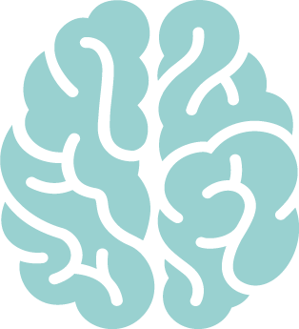
Self-Compassion
Self-Kindness
Common Humanity
Mindfulness
Show warmth and understanding to ourselves rather than being self-critical
Imperfection and struggles are part of the shared human experience
We are not alone.
Observe our struggle, negative thoughts or emotions without self-judgment or overreaction
Notes:
Instructor notes:
Not in CMW
Kristin Neff’s 3 elements of self-compassion
Self-kindness vs. Self-judgment - Warm and understanding toward ourselves when we suffer, fail, or feel inadequate instead of ignoring our pain or beating ourselves up with self-criticism;
Mistakes, imperfections are inevitable; If we fight against this reality, it leads to stress, frustration and self-criticism; If we accept this reality with sympathy and kindness, greater emotional equanimity can be achieved; Emotional equanimity = “state of psychological stability and composure which is undisturbed by experience or exposure to emotions, pain, or (equanimity is a concept discussed by many religions)
Common humanity vs. Isolation - Recognition that suffering and personal inadequacy is part of the shared experience…something we all go through rather than being something that happens to “me” alone
Mindfulness vs. Over-identification - Balanced approach to our negative emotions so that feelings are neither suppressed nor exaggerated
This equilibrated stance stems from relating personal experiences to those of others who are also suffering, thus putting our own situation into a larger perspective.
Also stems from the willingness to observe negative thoughts and emotions with openness and clarity, so they are held in mindful awareness.
Mindfulness is a non-judgmental, receptive mind state in which one observes thoughts & feelings as they are, without trying to suppress or deny them.
We can’t ignore our pain and feel compassion for it at the same time. However, mindfulness also requires that we not be ‘over-identified’ with thoughts and feelings, so that we are caught up and swept away by negative reactivity.

Slide 15
Learning Self-Compassion: Interview with Kristin Neff
Notes:
Instructor Notes:
Learning Self-Compassion: An Interview with Kristin Neff
https://youtu.be/s0cawZpopXU

Slide 16
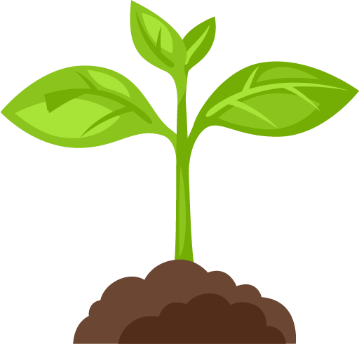
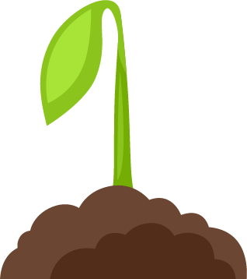
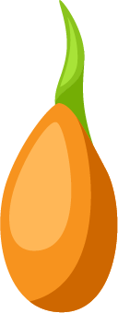
Cultivating Compassion
Notes:
Cultivating Compassion
Discuss the concept of cultivating your own compassion as you would cultivate/nurture a seed.

