Slide 1
Things to
be Thankful
for Today

Slide 2
C
Cultivating
Compassion
Why we need compassion:
Understanding our emotions
Chapter 3

Slide 3
Today’s Agenda
Things to be Thankful for Today
Three major emotion systems
What these systems organize
Describing each system
Systems out of balance
Sympathetic/Parasympathetic
Belly breathing practice

Slide 4
What emotions have you experienced so far today?

Slide 5
Three Major Emotion Systems
Threat System
Drive System
Soothing System

Slide 6
Threat & Self-Protection System
Threat-focused
Identify and respond to threats
Protection and safety-seeking
Activating/Inhibiting

Slide 7
Threat & Self-Protection System
Emotions = anger, anxiety, fear, disgust
Sympathetic nervous system
‘Fight, flight, freeze’
Adrenaline; cortisol

Slide 8
Insert image
Notes:
Under threat conditions, our attention and awareness is (further) biased to notice and pay disproportionate attention to threat cues over positive cues
explain the Negativity bias tying it into the ‘better safe than sorry’ wording of the book
From an evolutionary standpoint, it’s important that we have ways of paying attention to and prioritizing threats in our world (our brains and bodies have evolved to take the ‘better safe than sorry’ approach to potential threats); therefore, we prioritize these at the expense of positive experiences
This approach also influences our ‘new’ brain competencies, so when our threat systems are triggered, we are more likely to engage in worry, rumination, conjure up negative outcomes or interpretations (we may catastrophize) than if our threat systems weren’t activated
Give some other examples
Examples:
-I asked them something like “Tonight when you talk to your friend, romantic partner or family member, will you talk to them about the 1 bad thing that happened today or the several good things that happened today?” (this one worked well—students could relate and all seemed to agree)
-Faculty course evaluations: how we focus and ruminate on the few negative comments rather than the larger percentage of positive comments
(all seemed interested)
Remember that we/our brains are very responsive to our environments and experiences; if we experience certain threat-based environments (e.g., bullying, criticism, rejection) → lead to common patterns or loops in the mind (recall from Chp 1) that contributes to ongoing difficulties
(‘fire together, wire together’)
Undergoing these (mental) threat-directed loops, these patterns become easily activated → ongoing source of distress and suffering that is distinct from (although related) to threats we experience in the external world (e.g., people harming, criticizing or rejecting us)
Can make it challenging to live our lives in a balanced, helpful, and healthy way
Take a moment to think about your threat system – how often and what things (situations, experiences, thoughts, memories) tend to trigger it? (we won’t share this aloud)

Slide 9
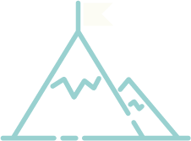
Drive System
Drive and Achievement-focused
Motivates us to move towards helpful resources and goals
Activating

Slide 10
Drive System
Emotions = excitement, joy, anticipation

Slide 11
Soothing-Affiliative System
Affiliative-focused
Soothing and Calming
Emotions/Feelings = caring, kindness, calmness, safety

Slide 12
Soothing-Affiliative System
Parasympathetic nervous system
‘rest and digest’; ‘tend and befriend’
vasopressin, oxytocin

Slide 13
What shapes how our 3 systems function?
What things tend to trigger each system?
What emotions do you experience in these situations?
What types of behaviors do you want to engage in when each system is triggered?
Notes:
What things (situations, experiences, thoughts, memories) tend to trigger your soothing-affiliative system?
What emotions (e.g., calm, contentment) do you experience in these situations?
What type of behaviors do you want to engage in when this system is triggered (e.g., relaxation, care-giving, care-receiving, etc.)?

Slide 14
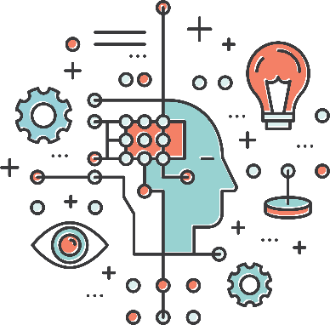
These Systems Organize our Mind
Cognition
Imagery/Fantasy
Attention
Thinking/Reasoning
Behavior
Motivation
Emotions

Slide 15
Systems out of Balance
skewed emotions, thoughts, attention, and behavior

Slide 16
Sympathetic & Parasympathetic Nervous Systems
Notes:
The sympathetic and parasympathetic nervous systems by Dr. Russ Harris (3:32)
https://youtu.be/R2825kDSo4M

Slide 17
Would you be willing to share a time where the presence of a loved one helped you during a potentially threatening/scary situation?

Slide 18
Belly Breathing
Notes:
Belly breathing practice

